Slide 1

Chinese Nation Silent Killer is Sewer Gas
下水道瓦斯是中華民族的無聲殺手
Professor Alex A. Volinsky, Ph.D. VOLINSKY@USF.EDU
Department of Mechanical Engineering
University of South Florida
WeChat: AlexVolinsky
南佛羅裡達大學
機械工程系
July 2024, P.R. China
Professor Alex A. Volinsky, Ph.D.
1

Slide 2
Disclaimer 免責聲明
The topic of this presentation is very serious because the plumbing and ventilation problems have not been fixed in China for decades.
There are multiple interconnected reasons that require systemic approach.
這次演講的主題非常嚴肅，因為中國的管道和通風問題幾十年來都沒有解決。有多個相互關聯的原因需要係統性的方法。
Professor Alex A. Volinsky, Ph.D.
2

Slide 3
What is Sewer Gas? 什麼是下水道煤氣？
Sewer gas is a combination of toxic and nontoxic gases that are a byproduct of human waste breaking down in sewer systems. It can have a poor odor or smell like methane or rotten eggs. Sewer gas can include gases like hydrogen sulfide, ammonia, carbon dioxide, methane, sulfur dioxide, esters, carbon monoxide, and nitrogen oxides.
下水道氣體是有毒和無毒氣體的組合，是人類排泄物在下水道系統中分解的副產品。它可能具有難聞的氣味或聞起來像甲烷或臭雞蛋。下水道氣體可包括硫化氫、氨、二氧化碳、甲烷、二氧化硫、酯、一氧化碳和氮氧化物等氣體。
Professor Alex A. Volinsky, Ph.D.
3

Slide 4
Effects of Sewer Gas 下水道氣體的影響
與下水道氣體暴露相關的健康風險包括：
硫化氫中毒：硫化氫聞起來像臭雞蛋，即使濃度很低。接觸低含量的硫化氫會引起眼睛和呼吸道刺激。其他症狀包括：
頭暈、嗜睡、頭痛、噁心、緊張
在高濃度下，硫化氫會幹擾嗅覺，使人們更難利用氣體的獨特氣味作為警訊。在極高濃度下，硫化氫會導致意識喪失和死亡。
The health risks linked to sewer gas exposure include:
Hydrogen sulfide poisoning: Hydrogen sulfide smells like rotten eggs, even in low concentrations. Exposure to low levels of hydrogen sulfide can cause eye and respiratory irritation. Other symptoms include:
Dizziness, Drowsiness, Headaches, Nausea, Nervousness
At high concentrations, hydrogen sulfide can interfere with the sense of smell, making it harder to use the gas’s distinct odor as a warning sign. In extremely high concentrations, hydrogen sulfide can cause loss of consciousness and death.
Dhs.Wisconsin.gov H₂S
Professor Alex A. Volinsky, Ph.D.
4

Slide 5
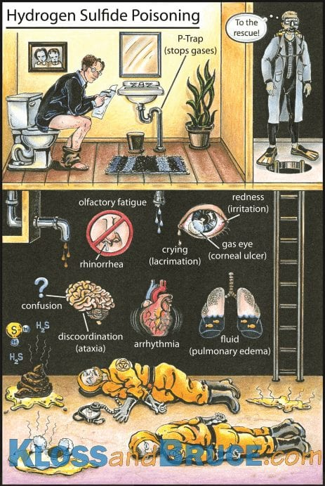
H₂S Poisoning Illustration H₂S 中毒插圖
https://litfl.com/hydrogen-sulfide-poisoning/
.
This cartoon by Brian Kloss and Travis Bruce summarizes all the signs and symptoms of hydrogen sulfide poisoning.
布萊恩·克勞斯 (Brian Kloss) 和特拉維斯·布魯斯 (Travis Bruce) 創作的這幅漫畫總結了硫化氫中毒的所有跡象和症狀。
Professor Alex A. Volinsky, Ph.D.
5

Slide 6
Suffocation 窒息
窒息：封閉區域內高濃度的甲烷會減少空氣中的氧氣含量，並可能導致窒息。缺氧的症狀包括：
頭暈、頭痛、噁心、意識不清
非常低的氧氣濃度水平（低於 12%）會在沒有任何警告的情況下很快導致意識不清和死亡。下水道氣體最集中的地方是進入房屋的地方，通常是地下室。
Suffocation: High concentrations of methane in enclosed areas decrease the amount of oxygen in the air and can cause suffocation. Symptoms of a lack of oxygen include:
Dizziness, Headaches, Nausea, Unconsciousness
Very low oxygen concentration levels (less than 12%) can cause unconsciousness and death very quickly and without warning. The most concentrated levels of sewer gas collect where it’s entering the home, which is often in basements.
Dhs.Wisconsin.gov
Professor Alex A. Volinsky, Ph.D.
6

Slide 7
Explosion and Fire 爆炸和火災
Explosion and fire: Methane and hydrogen sulfide gases are both flammable and highly explosive.
The severity of health risks can vary from person to person. A person’s reaction can depend on several things, such as Heredity and Individual health.
Previous exposure to chemicals, including through medicines and habits like smoking and drinking.
Severity also depends on the length of the exposure, the concentration of the gas, and whether it was eaten, inhaled, or touched.
Dhs.Wisconsin.gov
爆炸和火災：甲烷和硫化氫氣體均易燃且極易爆炸。
健康風險的嚴重程度因人而異。一個人的反應可能取決於幾個因素，例如遺傳和個人健康。
以前接觸過化學物質，包括透過藥物和吸煙、飲酒等習慣。
嚴重程度也取決於暴露時間的長短、氣體的濃度以及是否被吃掉、吸入或觸摸。
Professor Alex A. Volinsky, Ph.D.
7

Slide 8
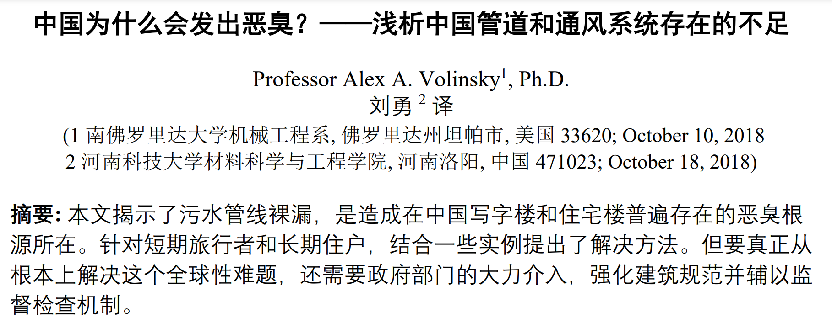
Why China Stinks? Deficiencies in Chinese Plumbing and Ventilation Systems, A.A. Volinsky, Y. Liu, 2018
English: A.A. Volinsky, International Journal of Civil Engineering and Technology, Vol. 11(7), pp. 16-20, 2020
Russian: A.A. Volinsky, S.O.K. Plumbing, Heating, Air-conditioning, Vol. 10, pp. 22-24, 2021
Professor Alex A. Volinsky, Ph.D.
8

Slide 9
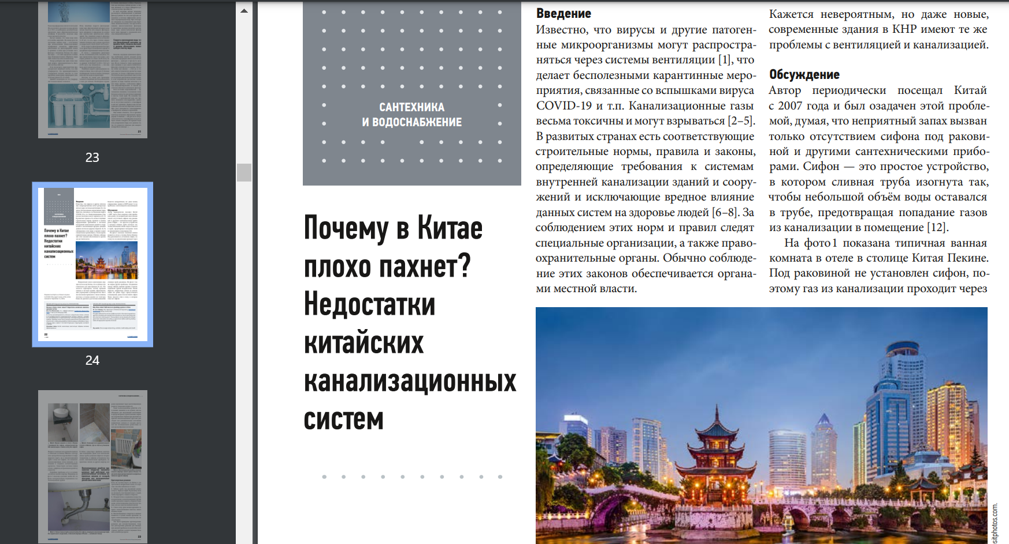
為什麼中國聞起來很糟糕。中國污水處理系統的缺點
Professor Alex A. Volinsky, Ph.D.
9

Slide 10
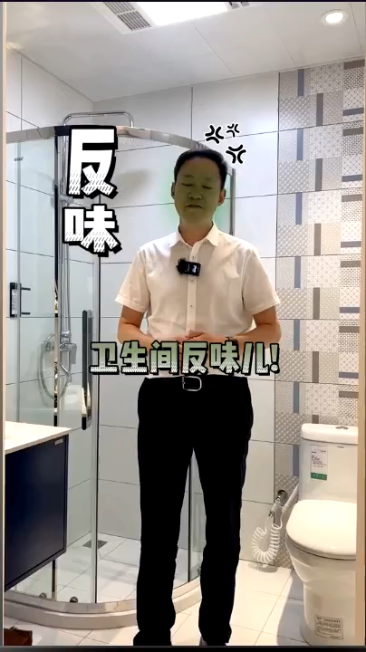
Causes of Bad Smell in WC 廁所異味的原因解釋
WC means Water Closet, or simply bathroom
https://www.douyin.com/video/7141320180952468773
Professor Alex A. Volinsky, Ph.D.
10

Slide 11
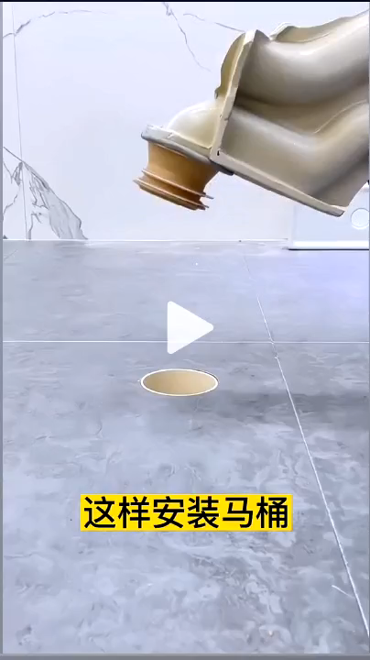
Device to Properly Install Toilet 正確安裝馬桶的裝置
Must be used for every toilet installation in China
中國每個廁所安裝都必須使用
https://www.douyin.com/video/7167317554631904523
Professor Alex A. Volinsky, Ph.D.
11

Slide 12
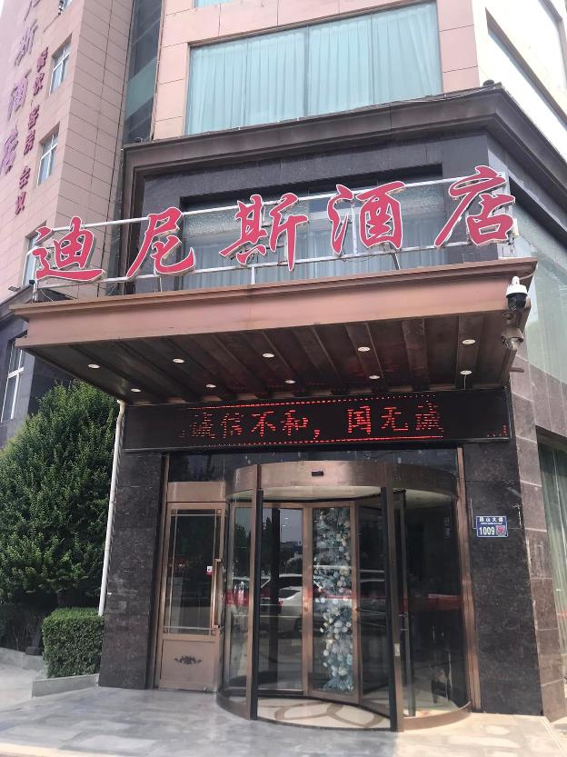
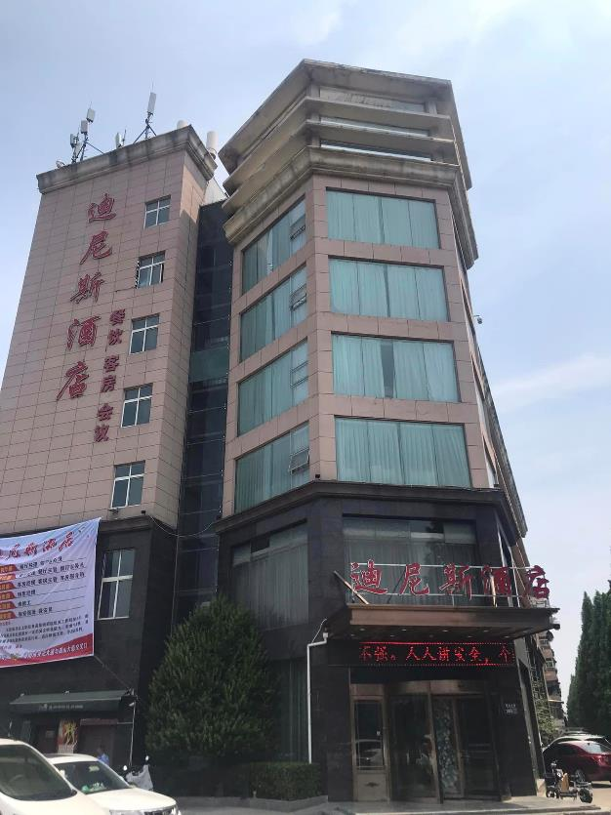
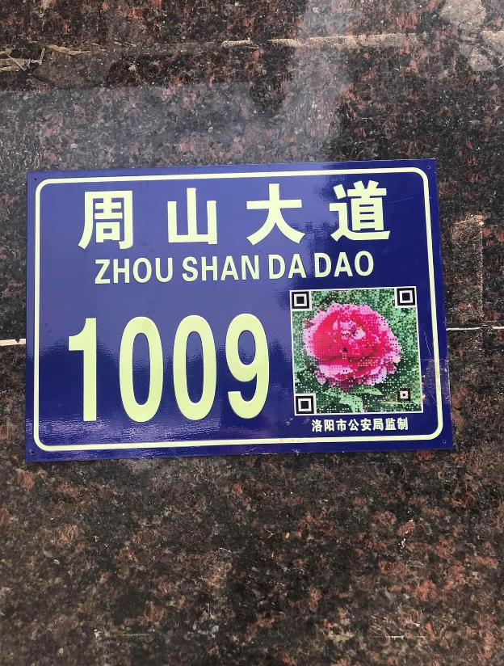
Dinis Business Hotel. Luoyang 迪尼斯商務飯店。洛陽
Thousands of hotels like this all over China
中國各地有上千家這樣的飯店
Every room on the third floor was remodeled in 2023
三樓所有房間均於2023年重新裝修
Professor Alex A. Volinsky, Ph.D.
12

Slide 13
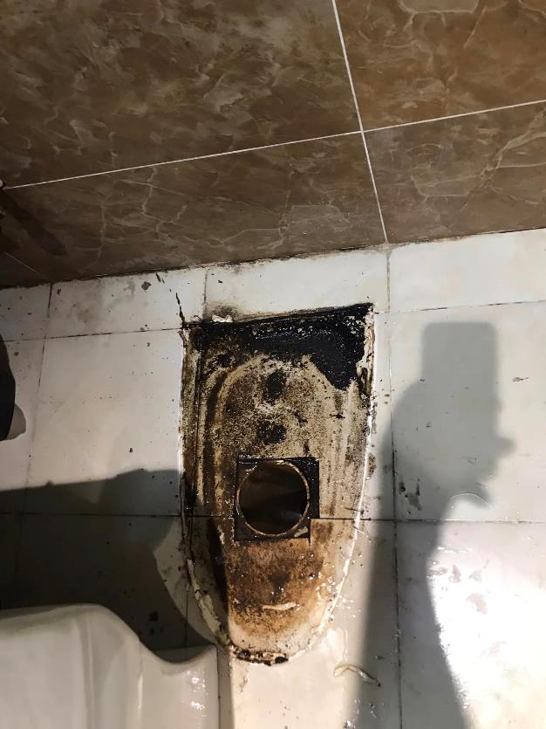
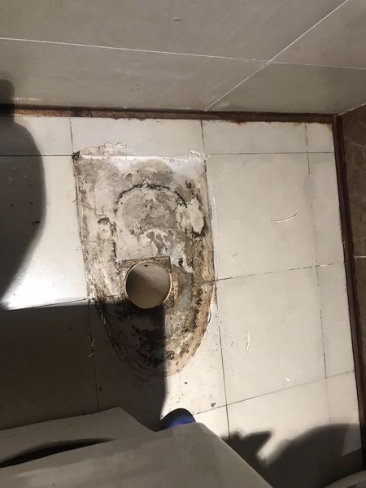
Toilet Improper Installation 馬桶安裝不當
Room 8326 after remodel Room 8623 no remodel
8326室改造後 8623室未改造
Unsealed toilet leaking sewage
廁所未密封漏污水
Off pipe center
離管中心
Professor Alex A. Volinsky, Ph.D.
13

Slide 14
Building Code 建築規範
A building code is a set of rules that specify the standards for construction objects such as buildings and non-building structures. Buildings must conform to the code to obtain planning permission, usually from a local authority.
建築規範是一組規定建築和非建築結構等建築對象標準的規則。建築物必須符合規範才能獲得規劃許可（通常來自地方當局）。
Building codes apply to all sorts of real estate, both commercial and residential. Older buildings must be “brought up to code” - that is, updated to current standards. If they fail to be updated, a building inspector could deem them unfit to live or work in.
建築規範適用於各種房地產，包括商業和住宅。舊建築必須「達到規範」——即更新至當前標準。如果它們未能更新，建築檢查員可能會認為它們不適合居住或工作。
Building code protects from mistakes 建築規範可防止錯誤
Professor Alex A. Volinsky, Ph.D.
14

Slide 15
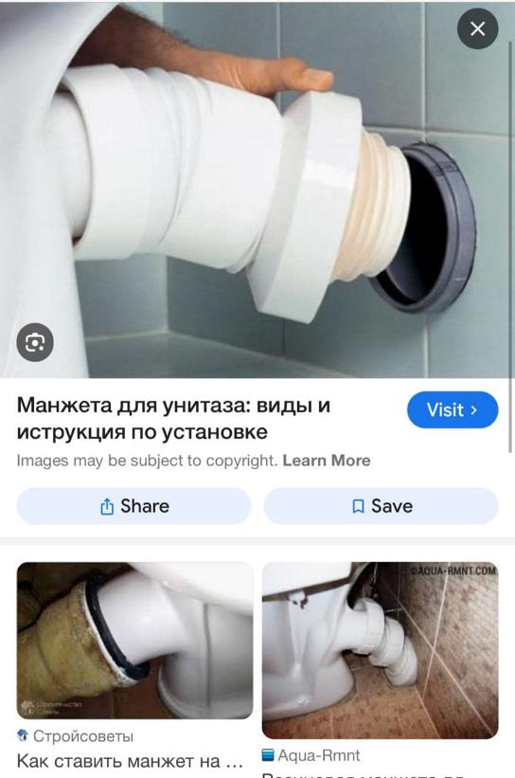
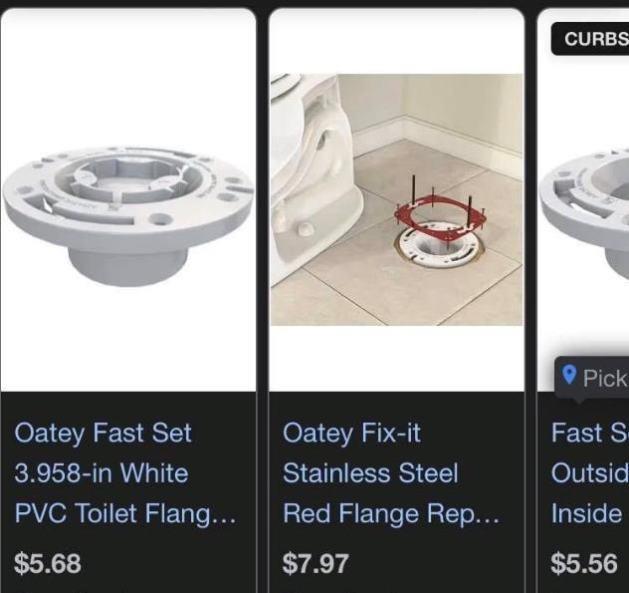
Toilet Installation 馬桶安裝
FL building code requires a flange, screws and wax ring
美國建築規範要求法蘭、螺絲和蠟環
European design is better
歐洲設計比較好
Exhaust pipe is outside
排氣管在外面
Prevents improper toilet installation. Bullet-proof design
防止馬桶安裝不當。防彈設計
Professor Alex A. Volinsky, Ph.D.
15

Slide 16
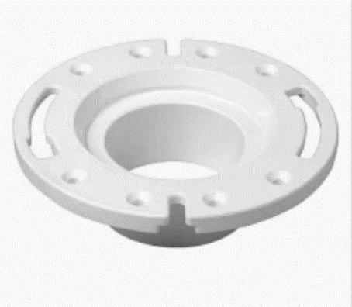
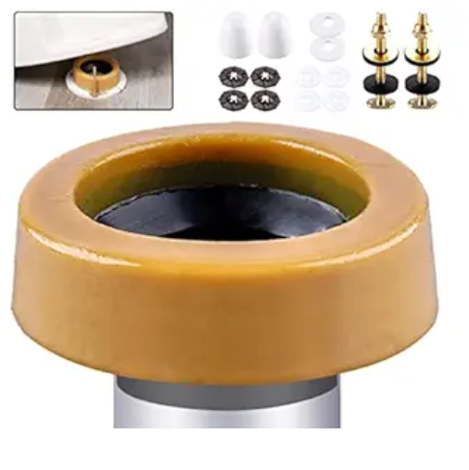
Flange and Gasket 法蘭和墊片
Florida building code requires a closet flange or waste connector and sealing gasket to join drainage piping to water closets. The flange must be securely fastened to a firm base. The thickness of the floor flange depends on the material it's made from.
佛羅裡達州建築規範要求使用壁櫥法蘭或廢物連接器和密封墊片將排水管道連接到抽水馬桶。法蘭必須牢固地固定在堅固的底座上。地板凸緣的厚度取決於其製成的材料。
Oversized wax ring
超大蠟環
Flange
法蘭
Professor Alex A. Volinsky, Ph.D.
16

Slide 17
Water P-Trap by Code 代碼中的分水器
The Florida Building Code requires that all plumbing fixtures be equipped with a trap. The most common trap is a P-trap, and there are several rules for installing fixture traps, including: 1. Traps must be self-cleaning and not rely on movable parts to maintain the water seal; 2. Trap outlets cannot be larger than the fixture drain they connect to; 3. The water seal should be between 2 and 4 inches; 4. Traps must be installed level in relation to their water seal; 5. Fixtures cannot be double trapped; 6. The vertical distance from the fixture outlet to the trap weir should not exceed 24 inches, and the horizontal distance should not exceed 30 inches
佛羅裡達州建築規範要求所有管道裝置均配備存水彎。最常見的存水彎是P型存水彎，安裝固定式存水彎有幾個規則，包括： 1.存水彎必須具有自潔性，不能依靠活動部件來維持水封； 2. 存水彎出口不能大於其連接的固定排水管； 3、水封應在2～4吋之間； 4. 疏水閥的安裝必須與水封水平； 5、夾具不能雙重困； 6.治具出口至疏水堰的垂直距離不應超過24英寸，水平距離不應超過30英寸
Professor Alex A. Volinsky, Ph.D.
17

Slide 18
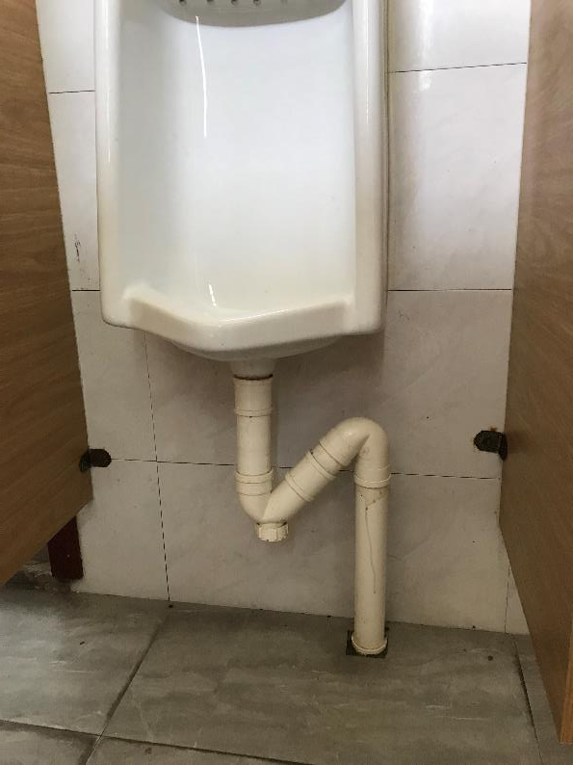
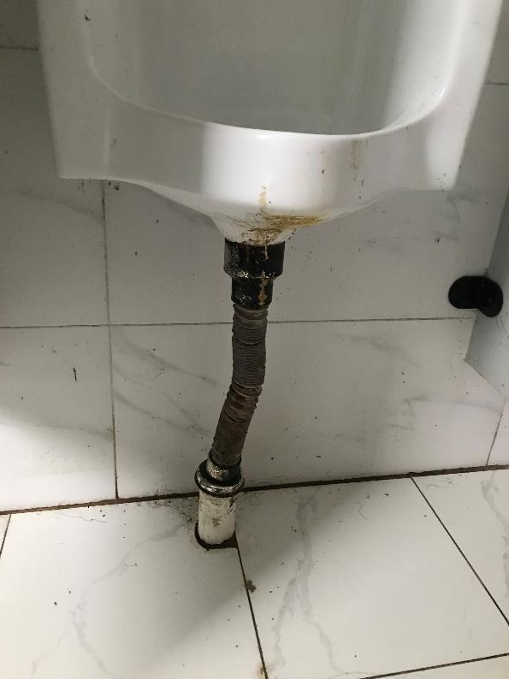
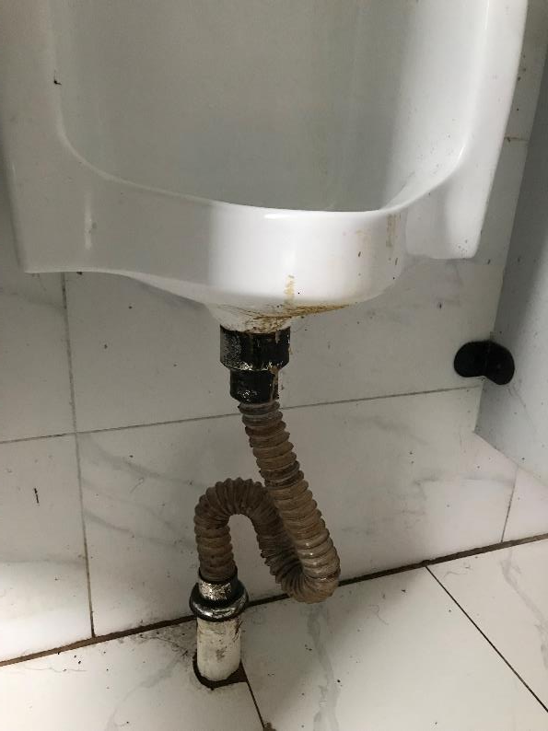
Which Installation is Correct? 哪種安裝是正確的？
No trap, or trap in the main pipe?
沒有存水彎，或主管中有存水彎？
Double trap?
雙陷阱？
Double trap?
雙陷阱？
The answer is unknown because the rest of the building plumbing is unknown
答案未知，因為建築物的其餘管道未知
Professor Alex A. Volinsky, Ph.D.
18

Slide 19
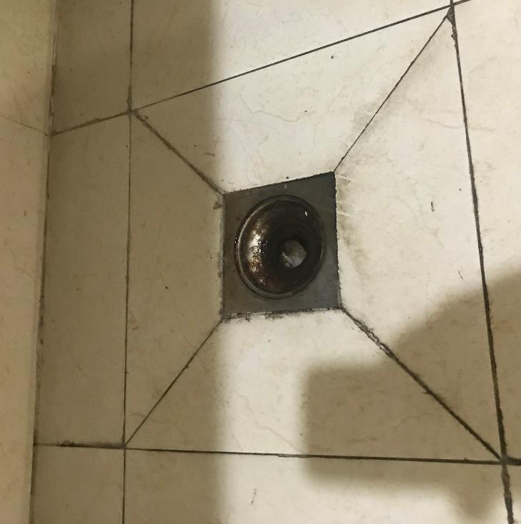
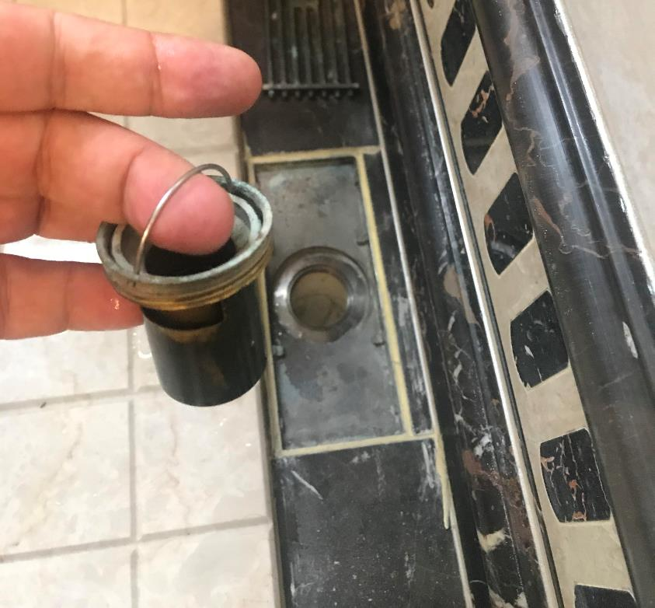
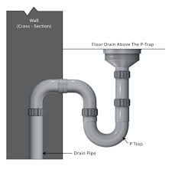
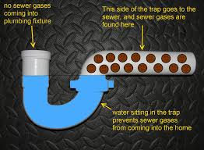
Floor Drain 地面排水口
Floor drain pipe must have a trap
地漏管道必須有存水彎
Drain insert with a trap
帶存水彎的排水插件
Professor Alex A. Volinsky, Ph.D.
19

Slide 20
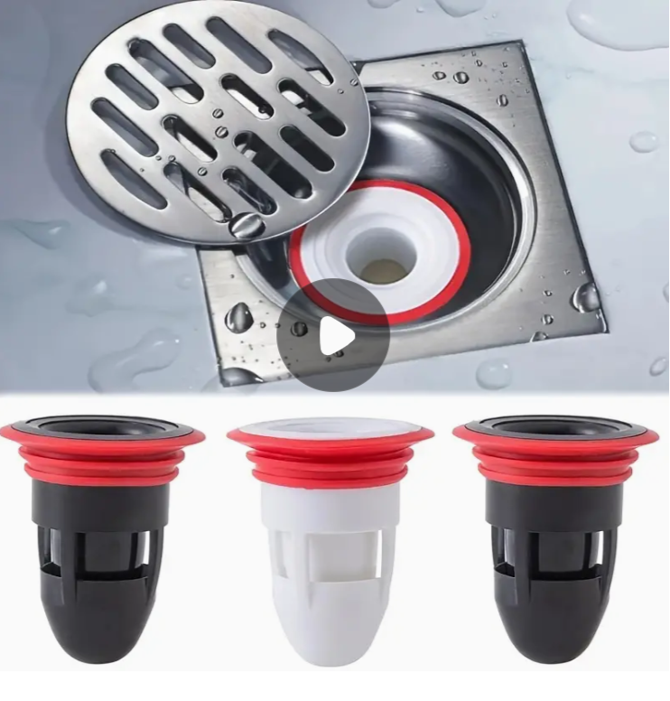
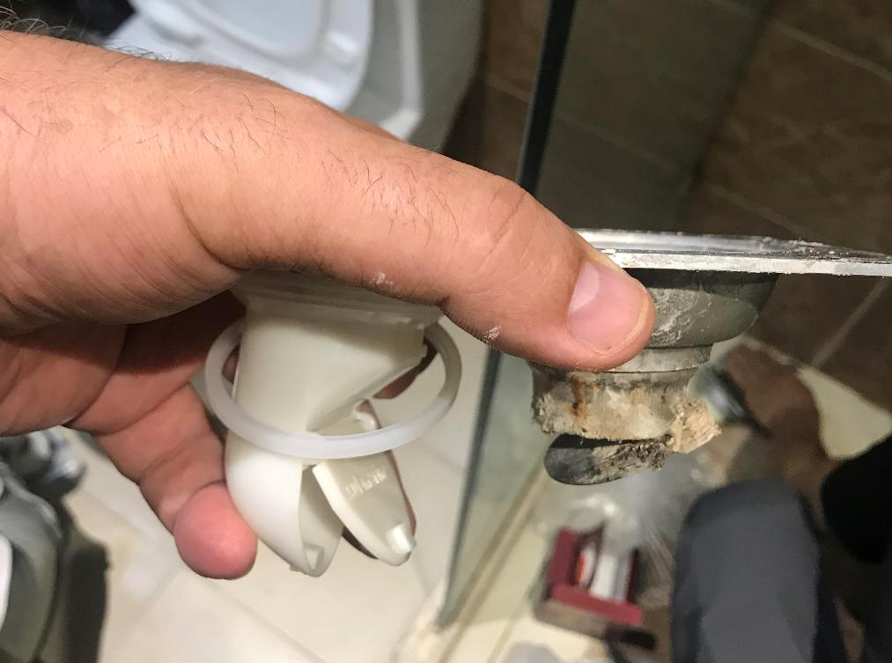
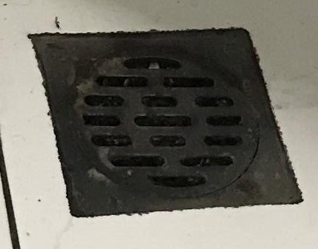
Only P-Trap, No Flapper Valve 僅 P 型疏水閥，無擋板閥
Flapper valve lets sewer gas go through
擋板閥讓下水道氣體通過
Professor Alex A. Volinsky, Ph.D.
20

Slide 21
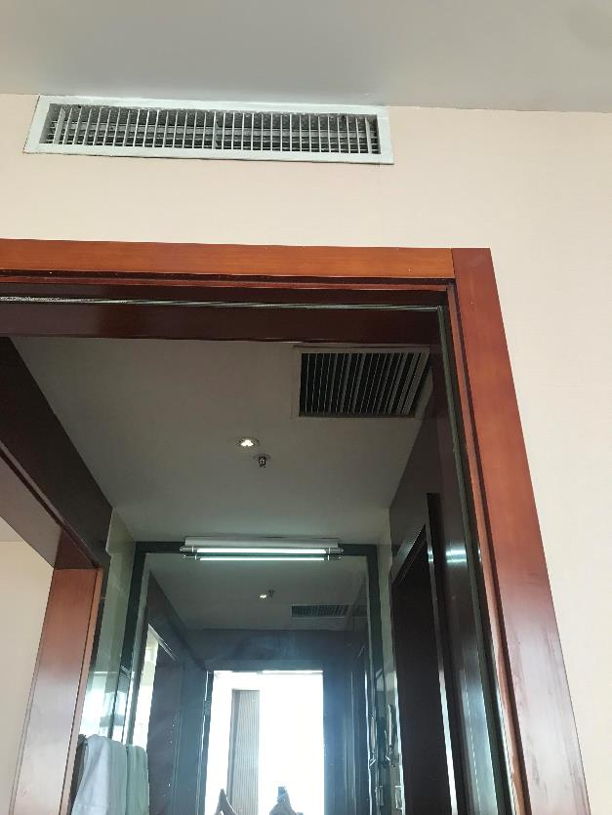
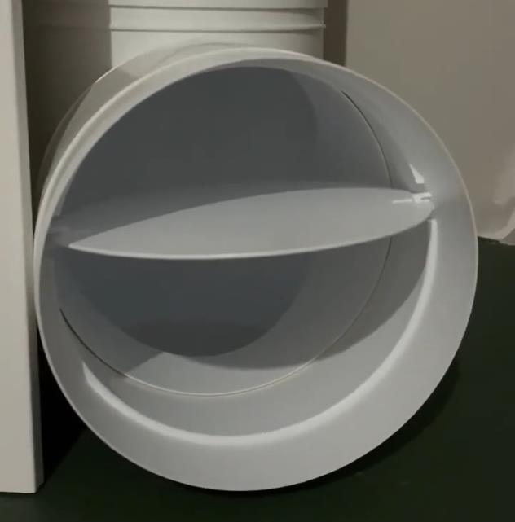
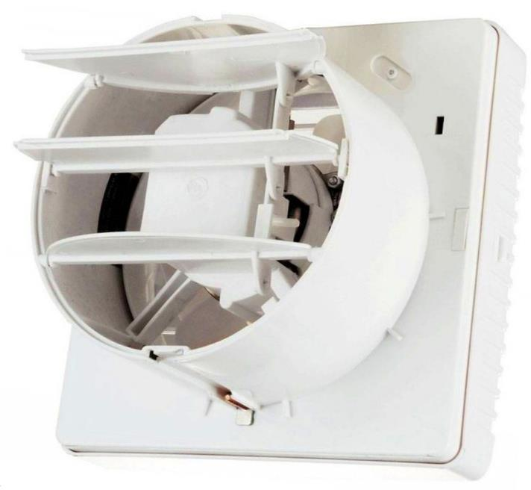
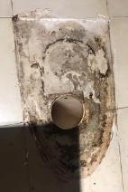
Ventilation 通風
Sewer gas comes from other rooms through ventilation vents
下水道氣體透過通風口來自其他房間
Causes of Odor in Kitchens, Bathrooms, and Toilets of Multi-story Residential Apartments with Natural Ventilation, A.A. Volinsky, International Journal of Civil Engineering and Technology, Vol. 15(1), pp. 27-35, 2024
Professor Alex A. Volinsky, Ph.D.
21

Slide 22
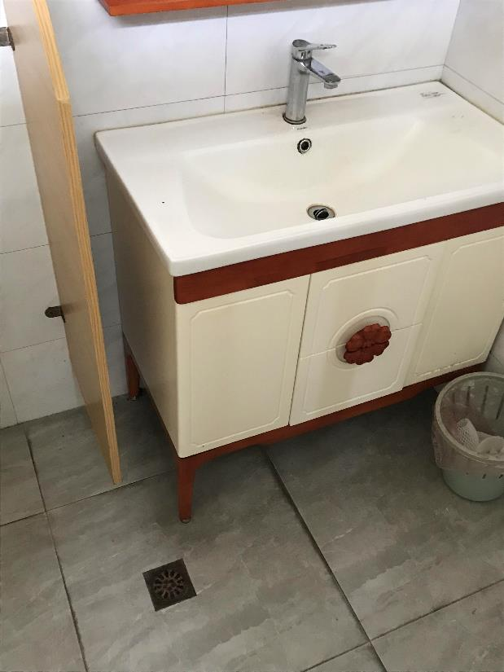
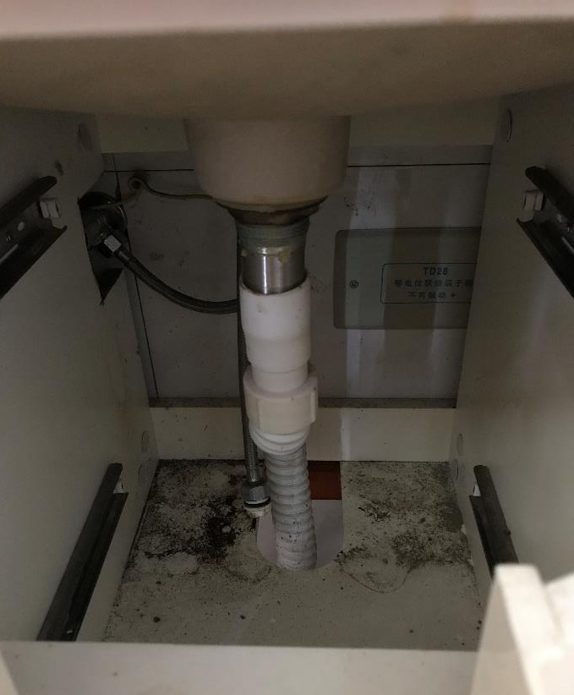
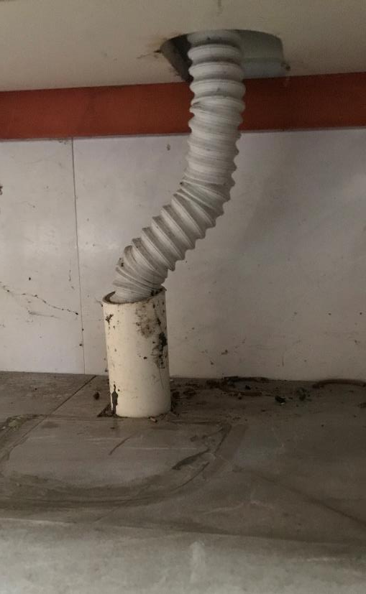
Vanity Installation 梳妝台安裝
No trap 無陷阱
Double trap?
雙陷阱？
Double trap?
雙陷阱？
No pipe seal
無管道密封
Professor Alex A. Volinsky, Ph.D.
22

Slide 23


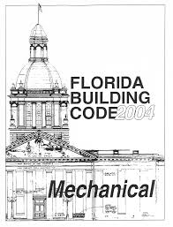
Florida Building Code 佛羅裡達州建築規範
2020 Florida Building Code, Plumbing, 7th Edition. Chapter 7 Sanitary Drainage
2020 年佛羅裡達州建築規範，管道，第 7 版。第7章 衛生排水
https://codes.iccsafe.org/content/FLPC2020P1/chapter-7-sanitary-drainage
Free access online
免費線上訪問
Professor Alex A. Volinsky, Ph.D.
23

Slide 24
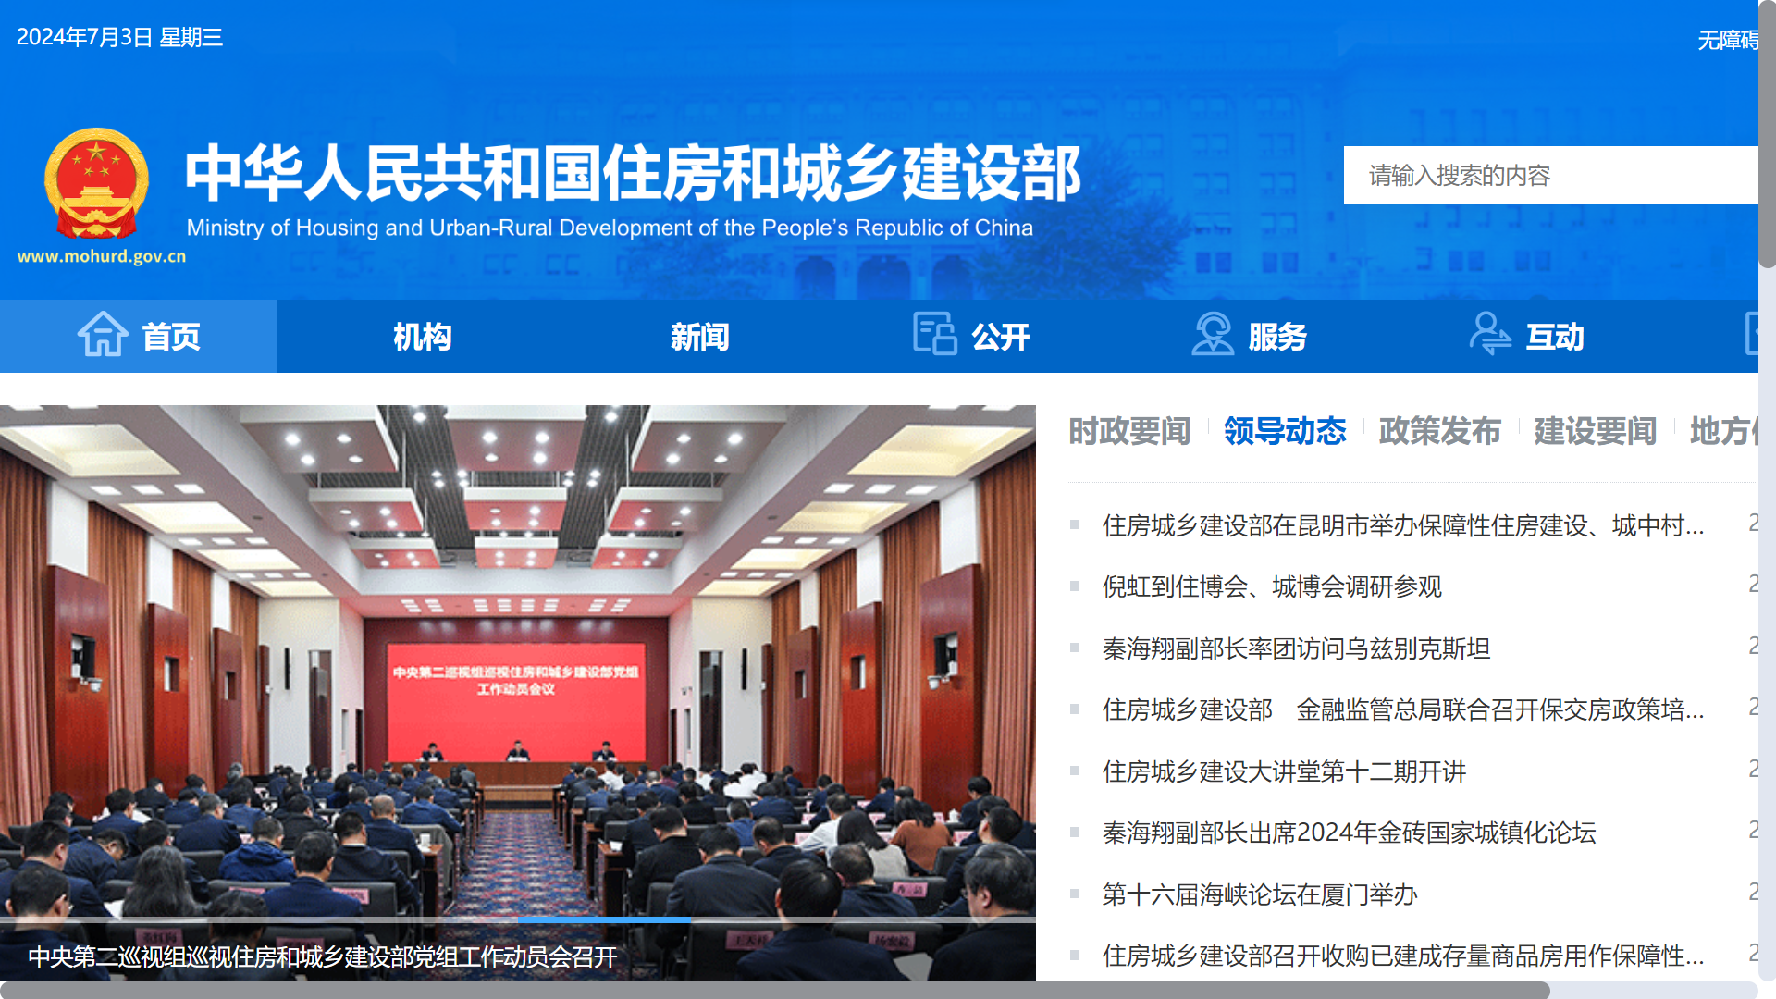
住房及城鄉建設部範
Building safety in China is regulated by the Ministry of Housing and Urban Rural Development (MOHURD) through a series of building safety standards
中國的建築安全由住房和城鄉建設部 (MOHURD) 透過一系列建築安全標準進行監管
Professor Alex A. Volinsky, Ph.D.
24

Slide 25
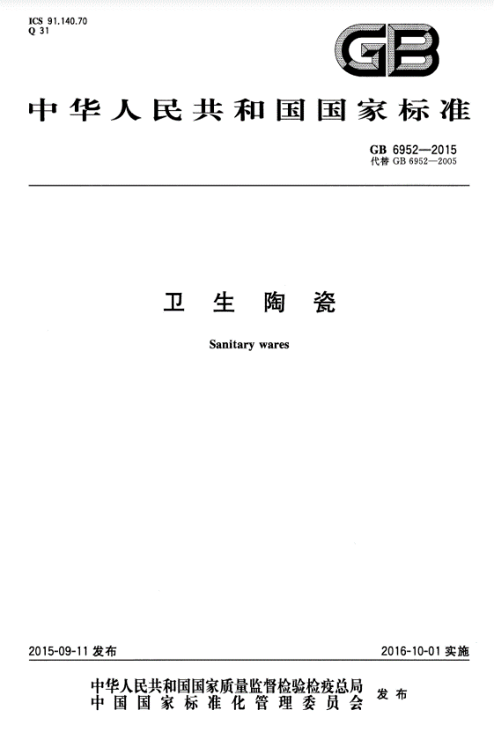
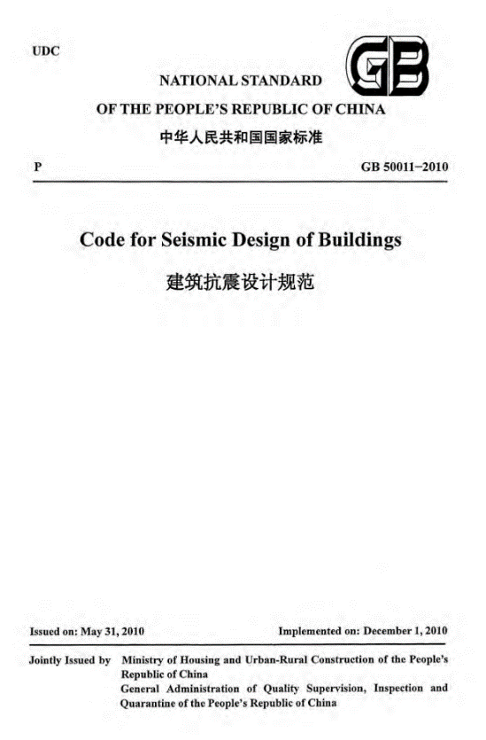
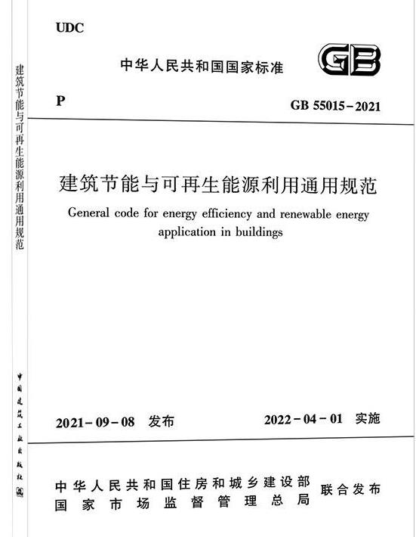
National Standards 國家標準
Which national standard requires P-trap and specifies proper toilet installation?
哪一個國家標準要求 P 型存水彎並規定了馬桶的正確安裝？
Professor Alex A. Volinsky, Ph.D.
25

Slide 26
Publications 刊物
中国为什么会发出恶臭？——浅析中国管道和通风系统存在的不足 Why China Stinks? Deficiencies in Chinese Plumbing and Ventilation Systems (in Chinese), A.A. Volinsky, Y. Liu, 2018
Why China Stinks. Deficiencies in Plumbing and Ventilation Systems in China, A.A. Volinsky, International Journal of Civil Engineering and Technology, Vol. 11(7), pp. 16-20, 2020
Causes of Odor in Kitchens, Bathrooms, and Toilets of Multi-story Residential Apartments with Natural Ventilation, A.A. Volinsky, International Journal of Civil Engineering and Technology, Vol. 15(1), pp. 27-35, 2024
Причины Неприятного Запаха в Ванных Комнатах и Туалетах Квартир МКД (Causes of a Nuisance Odor in the Bathrooms and Toilets of Apartments in Multi-story Buildings, in Russian), A.A. Volinsky, С.О.К. Сантехника, Отопление, Кондиционирование, 8, 46-48, 2022. S.O.K. Plumbing, Heating, Air-conditioning, Vol. 8, pp. 46-48, 2022
Почему в Китае Плохо Пахнет. Недостатки Канализационных Систем в Китае (Why China Stinks. Deficiencies in Plumbing Systems in China, in Russian), A.A. Volinsky, С.О.К. Сантехника, Отопление, Кондиционирование, 10, 22-24, 2021. S.O.K. Plumbing, Heating, Air-conditioning, Vol. 10, pp. 22-24, 2021
Professor Alex A. Volinsky, Ph.D.
26

Slide 27
Other Useful Publications 其他有用的出版物
A Case of Psoriasis Treatment Using Psorinum Autonosode, A.A. Volinsky, International Journal of Homoeopathic Sciences, Vol. 7(2), Part G, pp. 457-459, 2023
Two Cases of Isopathic and Homeopathic Treatment of Coronavirus Disease 2019, A.A. Volinsky, S.V. Gunter, International Journal of Homoeopathic Sciences, Vol. 5(3), Part E, pp. 321-323, 2021
A Clinical Case of Chronic Tonsillitis Treatment Using Homeopathy and Autonosodes, A.A. Volinsky, International Journal of Homoeopathic Sciences, Vol. 5(1), Part C, pp. 152-154, 2021
A Clinical Case of Homeopathic and Isopathic Treatment of Human Herpes Simplex Virus, A.A. Volinsky, International Journal of Homoeopathic Sciences, Vol. 5(1), Part C, pp. 146-148, 2021
Allergy Desensitization Based on Allergens Dynamization Method, A.A. Volinsky, International Journal of Homoeopathic Sciences, Vol. 4(4) Part D, pp. 198-201, 2020
Modified Qigong Breathing Exercise for Reducing the Sense of Hunger on an Empty Stomach, A.P. Voroshilov, A.A. Volinsky, Z. Wang, E.V. Marchenko, Journal of Evidence-based Complementary & Alternative Medicine, Vol. 22(4), pp. 687-695, 2017
Professor Alex A. Volinsky, Ph.D.
27

Slide 28
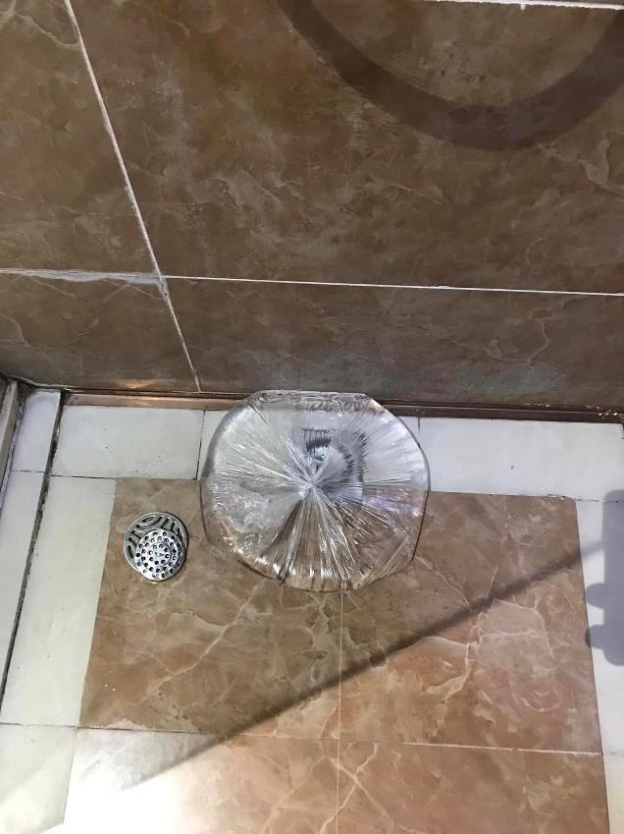
In the mean time 同時
I will keep putting plastic bag with water over all floor drains and avoid hotels with stinky sewage gas smell, make P-trap from flexible pipe, when possible, block ventilation vents, keep windows open.
Or maybe not travel to China at all, until these problems are fixed. Probably not in my lifetime.
我會繼續在所有地漏上放上裝有水的塑膠袋，並避開有惡臭污水氣味的飯店，盡可能用軟管製作P型存水彎，堵塞通風口，保持窗戶打開。
或者，在這些問題解決之前，也許根本不會去中國旅行。
If problems like this happened in the US, the whole building would be shutdown 如果美國出現這樣的問題，整棟大樓都會關閉
Professor Alex A. Volinsky, Ph.D.
28

Slide 29
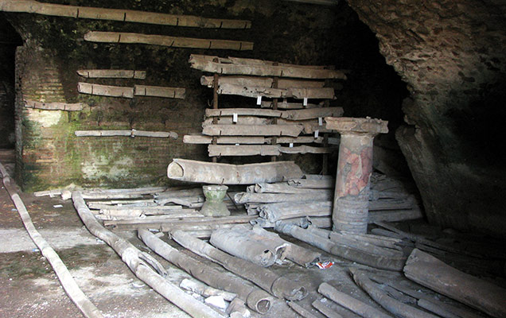
Ancient Rome Lead Pipes 古羅馬鉛管
In Ancient Rome lead was used for water pipes.
The word "plumbing" derives from plumbum, the Latin word for lead.
Don’t let sewer gas bring down Chinese Nation.
在古羅馬，鉛被用於水管。
「管道」一詞源自拉丁文“plumbum”，意為“鉛”。
別讓下水道毒氣毀了中華民族。
Tap water from ancient Rome likely contained up to 100 times more lead than local spring water
Thomas Sumner, ScienceShot: Did Lead Poisoning Bring Down Ancient Rome? Sediments downstream from Rome reveal health risks of empire's plumbing, Science, 21 Apr. 2014
In Nazi Germany people were killed in gas chambers in concentration camps.
在納粹德國，人們在集中營的毒氣室中被殺害。
Professor Alex A. Volinsky, Ph.D.
29

Slide 30
Conclusions 結論
Sewer gas exposure is a grossly neglected severe systemic problem in China
下水道氣體暴露是中國一個被嚴重忽視的嚴重系統性問題
Every bathroom has a floor drain without a water trap. Air flapper in the drain is no good. 每個浴室都有地漏，沒有存水彎。排水管中的空氣擋板不好
Sink installations are missing a water trap. Sink drain flapper is no good.
水槽安裝缺少聚水器。水槽排水擋板不好
Toilets are improperly installed and are not sealed 廁所安裝不當且未密封
Sewer gas is transported through ventilation systems from other apartments.
下水道氣體透過其他公寓的通風系統輸送
Ministry of Housing and Urban Rural Development must address and fix these problems. 住房和城鄉建設部必須正視和解決這些問題。
Professor Alex A. Volinsky, Ph.D.
30

