Slide 1

Chinese Nation Silent Killer is Sewer Gas
中华民族的隐形杀手是下水道气体
Professor Alex A. Volinsky, Ph.D. VOLINSKY@USF.EDU
Department of Mechanical Engineering
University of South Florida
WeChat: AlexVolinsky
机械工程系
南佛罗里达大学
July 2024, P.R. China
Professor Alex A. Volinsky, Ph.D.
1

Slide 2
Disclaimer 免责声明
The topic of this presentation is very serious because the plumbing and ventilation problems have not been fixed in China for decades.
There are multiple interconnected reasons that require systemic approach.
这次演讲的主题非常严肃，因为几十年来中国管道和通风问题一直没有得到解决。
有多个相互关联的原因，需要系统性的方法。
Professor Alex A. Volinsky, Ph.D.
2

Slide 3
What is Sewer Gas? 什么是下水道气体？
Sewer gas is a combination of toxic and nontoxic gases that are a byproduct of human waste breaking down in sewer systems. It can have a poor odor or smell like methane or rotten eggs. Sewer gas can include gases like hydrogen sulfide, ammonia, carbon dioxide, methane, sulfur dioxide, esters, carbon monoxide, and nitrogen oxides.
下水道气体是有毒和无毒气体的混合物，是人类排泄物在下水道系统中分解产生的副产品。下水道气体可能具有难闻的气味，或像甲烷或臭鸡蛋的味道。下水道气体可能包括硫化氢、氨、二氧化碳、甲烷、二氧化硫、酯类、一氧化碳和氮氧化物等气体。
Professor Alex A. Volinsky, Ph.D.
3

Slide 4
Effects of Sewer Gas 下水道气体的影响
与下水道气体接触相关的健康风险包括：
硫化氢中毒：硫化氢即使在低浓度下也会有臭鸡蛋的味道。接触低浓度的硫化氢会引起眼睛和呼吸道刺激。其他症状包括：
头晕、嗜睡、头痛、恶心、紧张
高浓度的硫化氢会干扰嗅觉，使人们更难将气体的独特气味用作警告信号。极高浓度的硫化氢会导致意识丧失和死亡。
The health risks linked to sewer gas exposure include:
Hydrogen sulfide poisoning: Hydrogen sulfide smells like rotten eggs, even in low concentrations. Exposure to low levels of hydrogen sulfide can cause eye and respiratory irritation. Other symptoms include:
Dizziness, Drowsiness, Headaches, Nausea, Nervousness
At high concentrations, hydrogen sulfide can interfere with the sense of smell, making it harder to use the gas’s distinct odor as a warning sign. In extremely high concentrations, hydrogen sulfide can cause loss of consciousness and death.
Dhs.Wisconsin.gov H₂S
Professor Alex A. Volinsky, Ph.D.
4

Slide 5
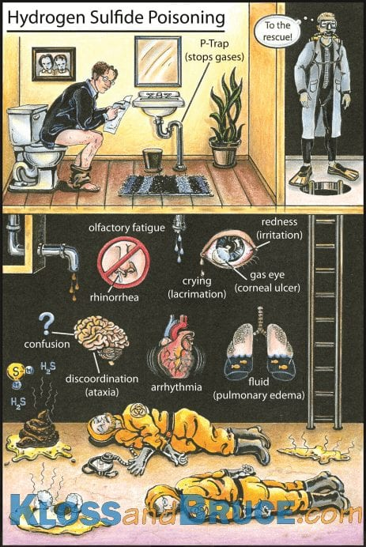
H₂S Poisoning Illustration H₂S 中毒图示
https://litfl.com/hydrogen-sulfide-poisoning/
.
This cartoon by Brian Kloss and Travis Bruce summarizes all the signs and symptoms of hydrogen sulfide poisoning.
这幅由 Brian Kloss 和 Travis Bruce 创作的漫画总结了硫化氢中毒的所有体征和症状。布萊恩·克勞斯 (Brian Kloss) 和特拉維斯·布魯斯 (Travis Bruce) 創作的這幅漫畫總結了硫化氫中毒的所有跡象和症狀。
Professor Alex A. Volinsky, Ph.D.
5

Slide 6
Suffocation 窒息
窒息：封闭区域中甲烷浓度过高会降低空气中的氧气量，并可能导致窒息。缺氧症状包括：
头晕、头痛、恶心、昏迷
氧气浓度极低（低于 12%）会导致昏迷和死亡，且没有任何预兆。最浓的下水道气体聚集在进入房屋的地方，通常是地下室。
Suffocation: High concentrations of methane in enclosed areas decrease the amount of oxygen in the air and can cause suffocation. Symptoms of a lack of oxygen include:
Dizziness, Headaches, Nausea, Unconsciousness
Very low oxygen concentration levels (less than 12%) can cause unconsciousness and death very quickly and without warning. The most concentrated levels of sewer gas collect where it’s entering the home, which is often in basements.
Dhs.Wisconsin.gov
Professor Alex A. Volinsky, Ph.D.
6

Slide 7
Explosion and Fire 爆炸和火灾
Explosion and fire: Methane and hydrogen sulfide gases are both flammable and highly explosive.
The severity of health risks can vary from person to person. A person’s reaction can depend on several things, such as Heredity and Individual health.
Previous exposure to chemicals, including through medicines and habits like smoking and drinking.
Severity also depends on the length of the exposure, the concentration of the gas, and whether it was eaten, inhaled, or touched.
Dhs.Wisconsin.gov
爆炸和火灾：甲烷和硫化氢气体都是易燃且高度易爆的。
健康风险的严重程度因人而异。一个人的反应可能取决于几个因素，例如遗传和个人健康状况。
之前接触过化学物质，包括通过药物和吸烟、饮酒等习惯。
严重程度还取决于接触时间长短、气体浓度以及是否食用、吸入或接触过。
Professor Alex A. Volinsky, Ph.D.
7

Slide 8
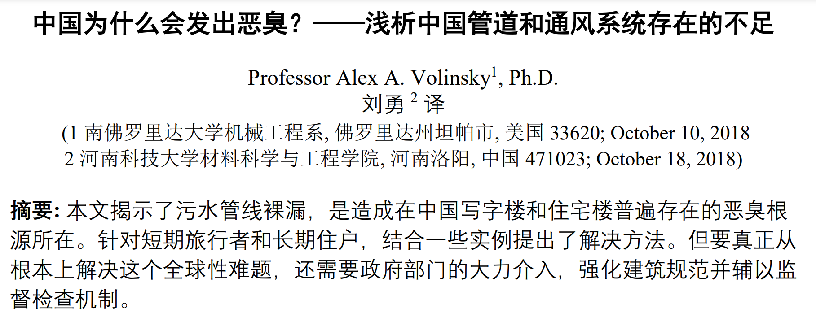
Why China Stinks? Deficiencies in Chinese Plumbing and Ventilation Systems, A.A. Volinsky, Y. Liu, 2018
English: A.A. Volinsky, International Journal of Civil Engineering and Technology, Vol. 11(7), pp. 16-20, 2020
Russian: A.A. Volinsky, S.O.K. Plumbing, Heating, Air-conditioning, Vol. 10, pp. 22-24, 2021
Professor Alex A. Volinsky, Ph.D.
8

Slide 9
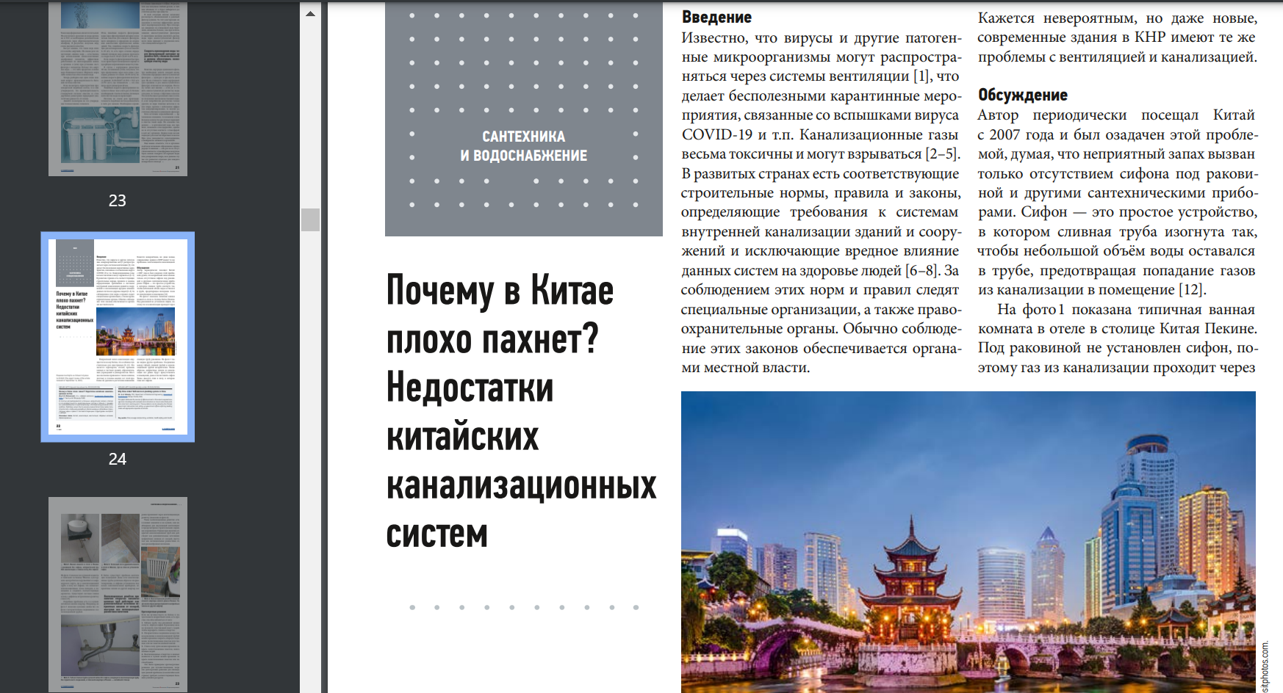
为什么中国闻起来很臭。中国污水处理系统的缺点
Professor Alex A. Volinsky, Ph.D.
9

Slide 10
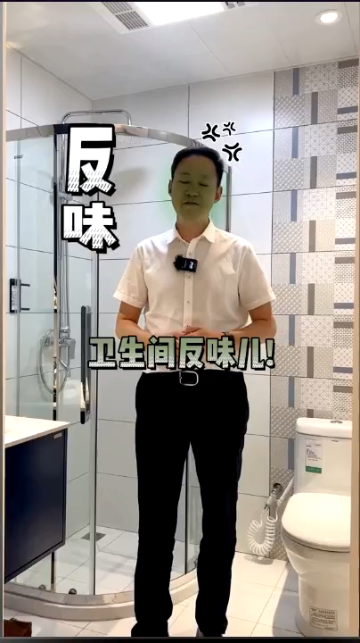
Causes of Bad Smell in WC 卫生间有异味的原因
WC means Water Closet, or simply bathroom
WC 表示水厕，或简称为浴室
https://www.douyin.com/video/7141320180952468773
Professor Alex A. Volinsky, Ph.D.
10

Slide 11
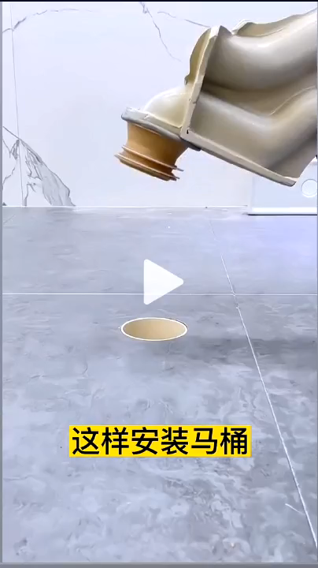
Device to Properly Install Toilet 正确安装马桶的装置
Must be used for every toilet installation in China
中国每个厕所安装都必须使用
https://www.douyin.com/video/7167317554631904523
Professor Alex A. Volinsky, Ph.D.
11

Slide 12
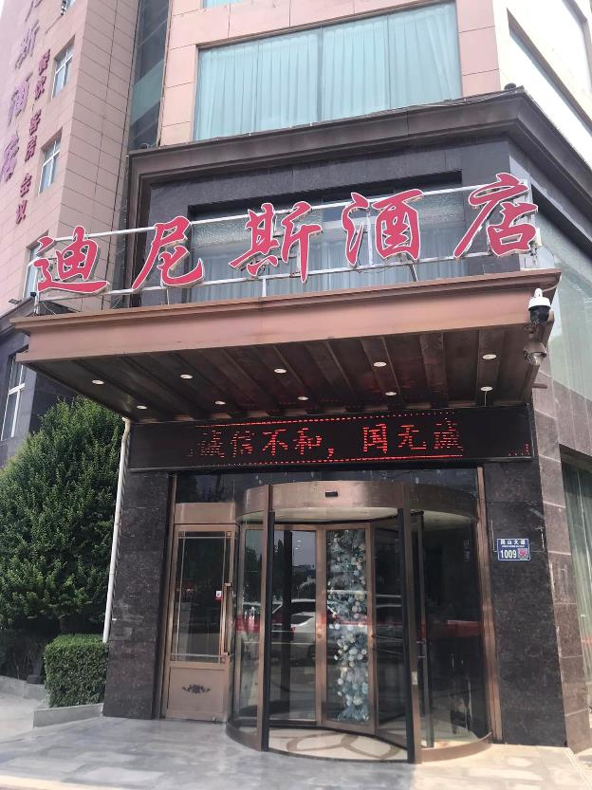
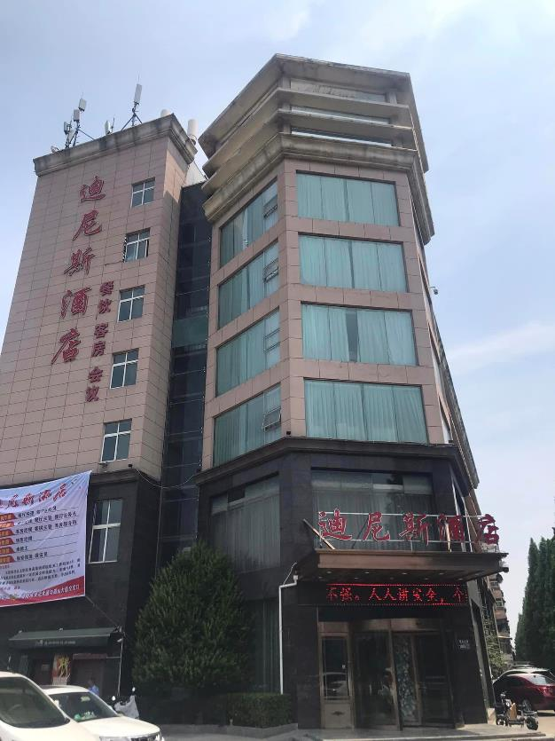
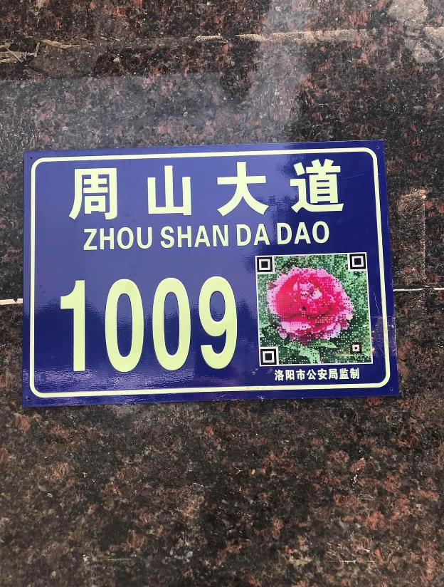
Dinis Business Hotel. Luoyang 迪尼斯商务酒店。洛阳
Thousands of hotels like this all over China
洛阳迪尼斯商务酒店
Every room on the third floor was remodeled in 2023
三楼所有房间均于2023年重新装修
Professor Alex A. Volinsky, Ph.D.
12

Slide 13
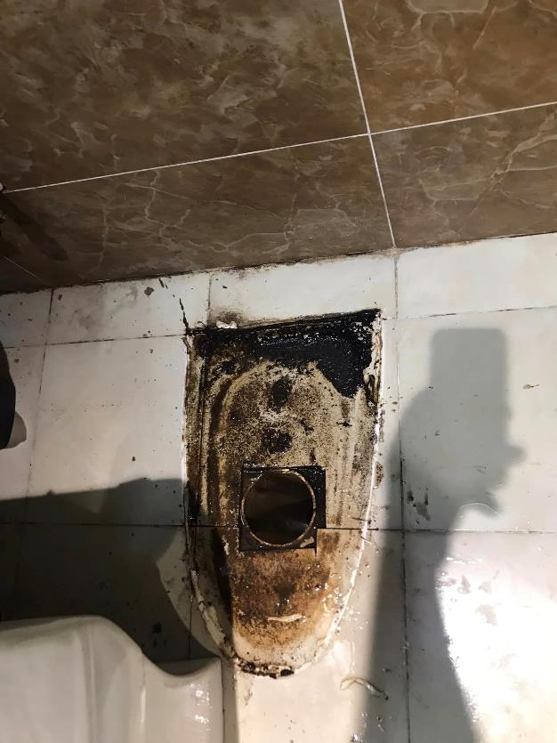
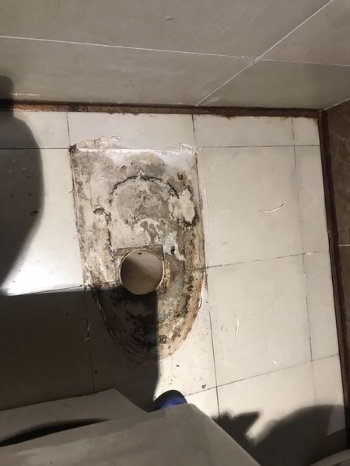
Toilet Improper Installation 马桶安装不当
Room 8326 after remodel Room 8623 no remodel
改造后的8326室 8623室无装修
Unsealed toilet leaking sewage
厕所未密封漏污水
Off pipe center
离管中心
Professor Alex A. Volinsky, Ph.D.
13

Slide 14
Building Code 建筑规范
A building code is a set of rules that specify the standards for construction objects such as buildings and non-building structures. Buildings must conform to the code to obtain planning permission, usually from a local authority.
建筑规范是一组规定建筑和非建筑结构等建筑对象标准的规则。建筑物必须符合规范才能获得规划许可（通常来自地方当局）。
Building codes apply to all sorts of real estate, both commercial and residential. Older buildings must be “brought up to code” - that is, updated to current standards. If they fail to be updated, a building inspector could deem them unfit to live or work in.
建筑规范适用于各种房地产，包括商业和住宅。旧建筑必须“达到规范”，即更新至当前标准。如果它们未能更新，建筑检查员可能会认为它们不适合居住或工作。
Building code protects from mistakes 建筑规范可防止错误
Professor Alex A. Volinsky, Ph.D.
14

Slide 15
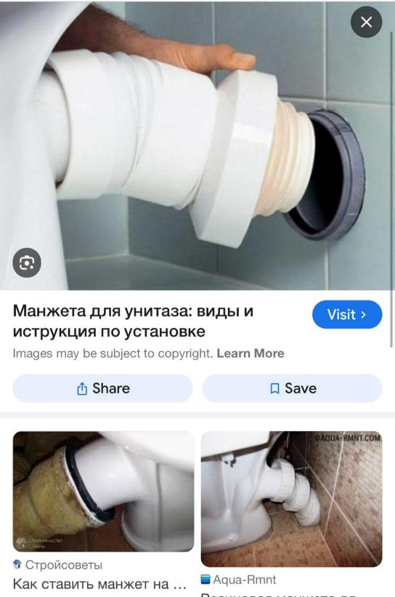
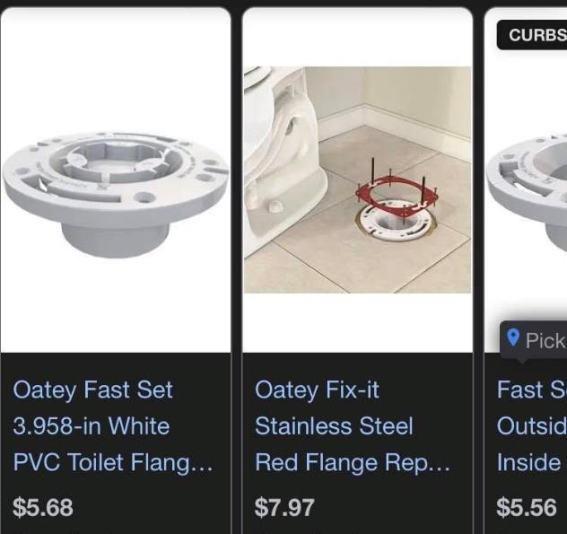
Toilet Installation 马桶安装
FL building code requires a flange, screws and wax ring
FL 建筑规范需要法兰、螺钉和蜡环
European design is better
欧洲设计比较好
Exhaust pipe is outside
排气管在外面
Prevents improper toilet installation. Bullet-proof design
防止马桶安装不当。防弹设计
Professor Alex A. Volinsky, Ph.D.
15

Slide 16
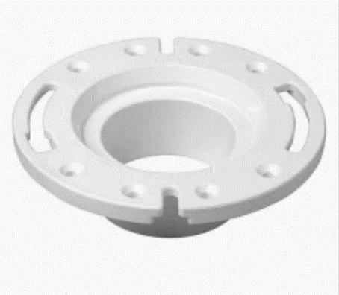
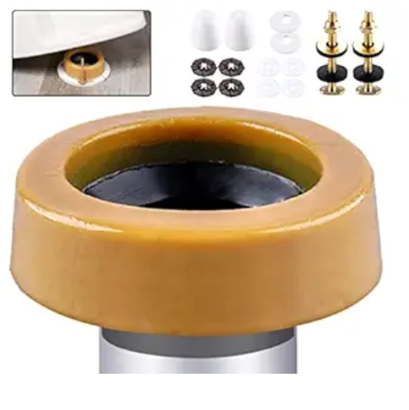
Flange and Gasket 法兰和垫片
Florida building code requires a closet flange or waste connector and sealing gasket to join drainage piping to water closets. The flange must be securely fastened to a firm base. The thickness of the floor flange depends on the material it's made from.
佛罗里达州建筑规范要求使用壁橱法兰或废物连接器和密封垫片将排水管道连接到抽水马桶。法兰必须牢固地固定在坚固的底座上。地板凸缘的厚度取决于其制成的材料。
Oversized wax ring
超大蜡环
Flange
法兰
Professor Alex A. Volinsky, Ph.D.
16

Slide 17
Water P-Trap by Code 水 P-Trap 代码
The Florida Building Code requires that all plumbing fixtures be equipped with a trap. The most common trap is a P-trap, and there are several rules for installing fixture traps, including: 1. Traps must be self-cleaning and not rely on movable parts to maintain the water seal; 2. Trap outlets cannot be larger than the fixture drain they connect to; 3. The water seal should be between 2 and 4 inches; 4. Traps must be installed level in relation to their water seal; 5. Fixtures cannot be double trapped; 6. The vertical distance from the fixture outlet to the trap weir should not exceed 24 inches, and the horizontal distance should not exceed 30 inches
佛罗里达州建筑规范要求所有管道装置均配备存水弯。最常见的存水弯是P型存水弯，安装固定式存水弯有几个规则，包括： 1.存水弯必须具有自清洁功能，不能依靠活动部件来维持水封； 2. 存水弯出口不能大于其连接的固定排水管； 3.水封应在2至4英寸之间； 4. 疏水阀的安装必须与水封水平； 5、夹具不能双重困； 6、治具出口至疏水堰的垂直距离不应超过24英寸，水平距离不应超过30英寸
Professor Alex A. Volinsky, Ph.D.
17

Slide 18
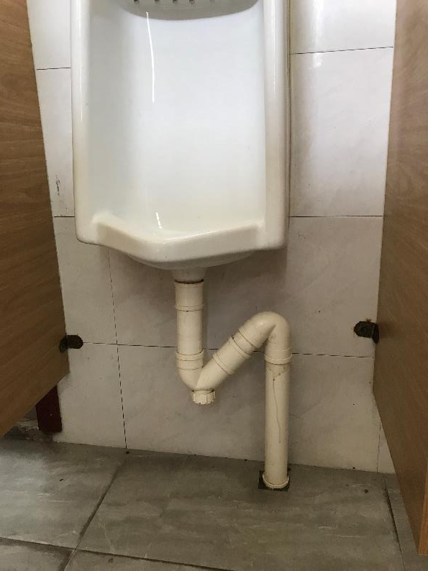
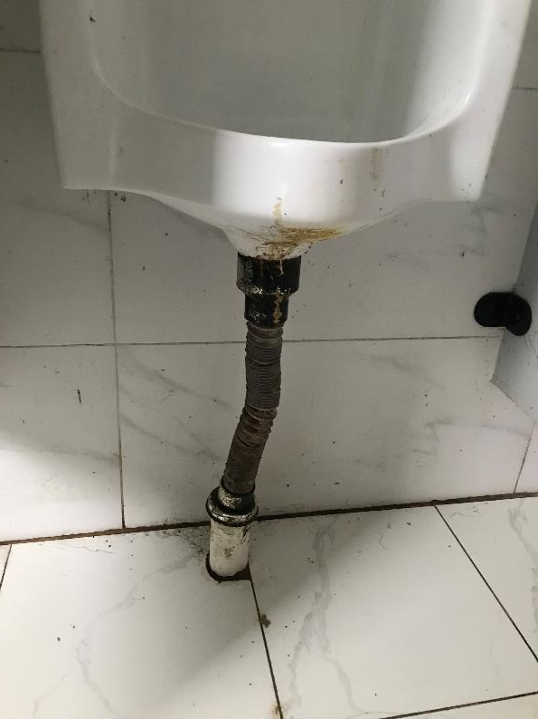
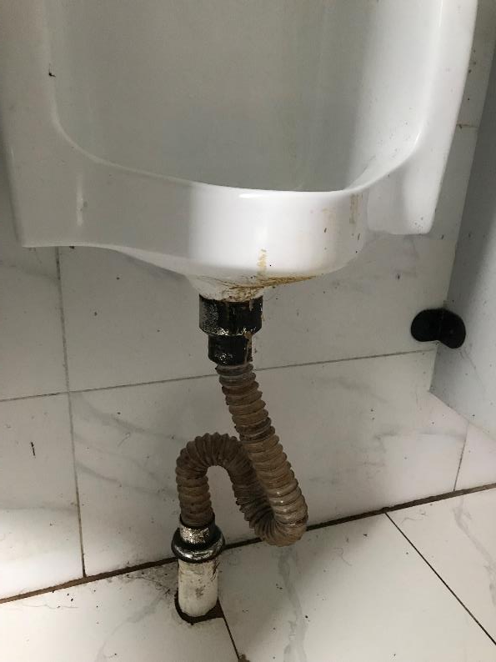
Which Installation is Correct? 哪种安装是正确的？
No trap, or trap in the main pipe?
没有存水弯，或者主管中有存水弯？
Double trap?
双陷阱？
Double trap?
双陷阱？
The answer is unknown because the rest of the building plumbing is unknown
答案未知，因为建筑物的其余管道未知
Professor Alex A. Volinsky, Ph.D.
18

Slide 19
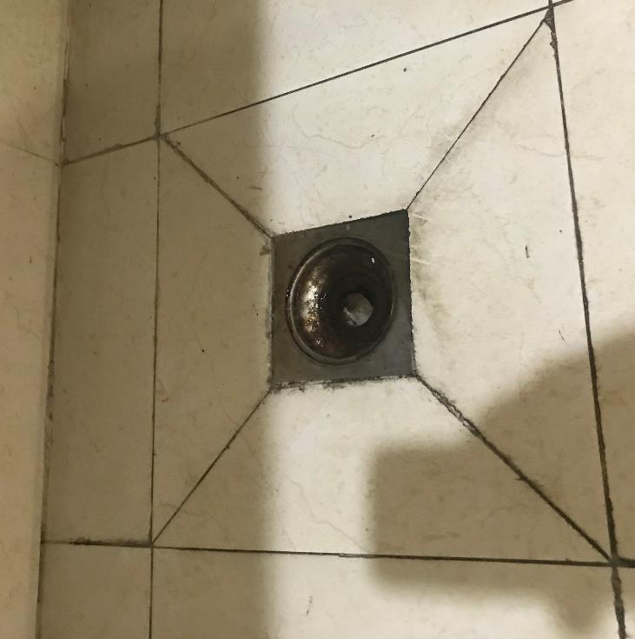
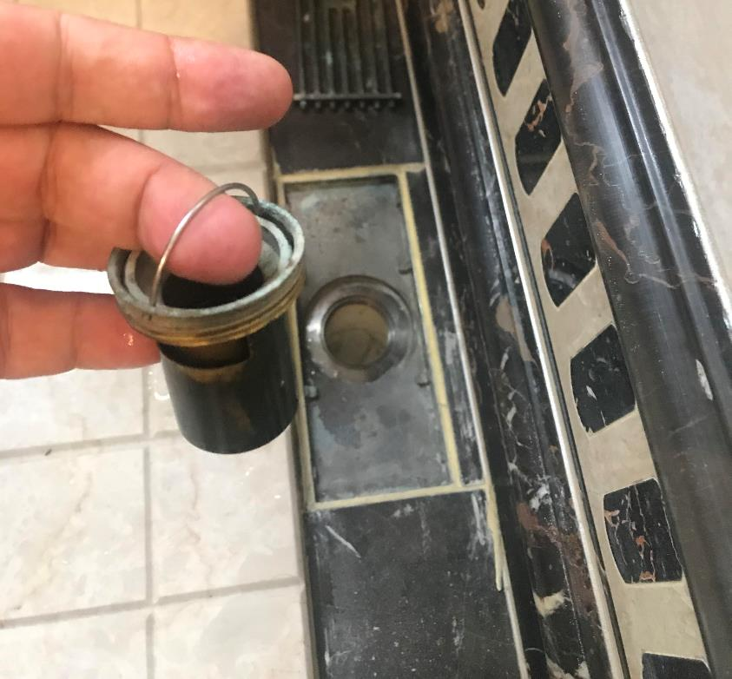
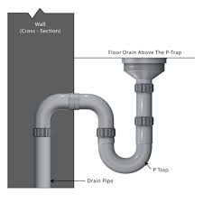
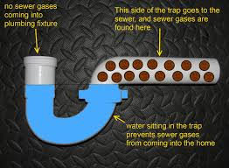
Floor Drain 地面排水口
Floor drain pipe must have a trap
地漏管道必须有存水弯
Drain insert with a trap
带存水弯的排水插件
Professor Alex A. Volinsky, Ph.D.
19

Slide 20
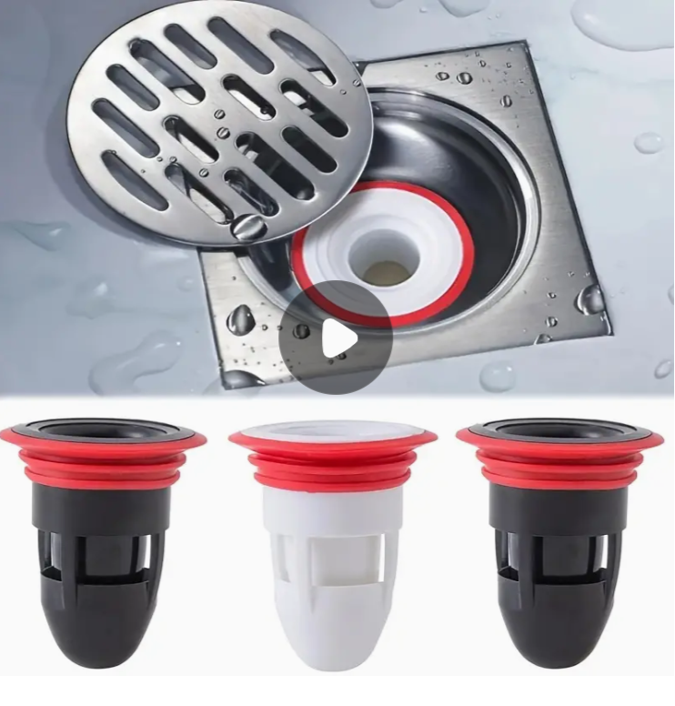
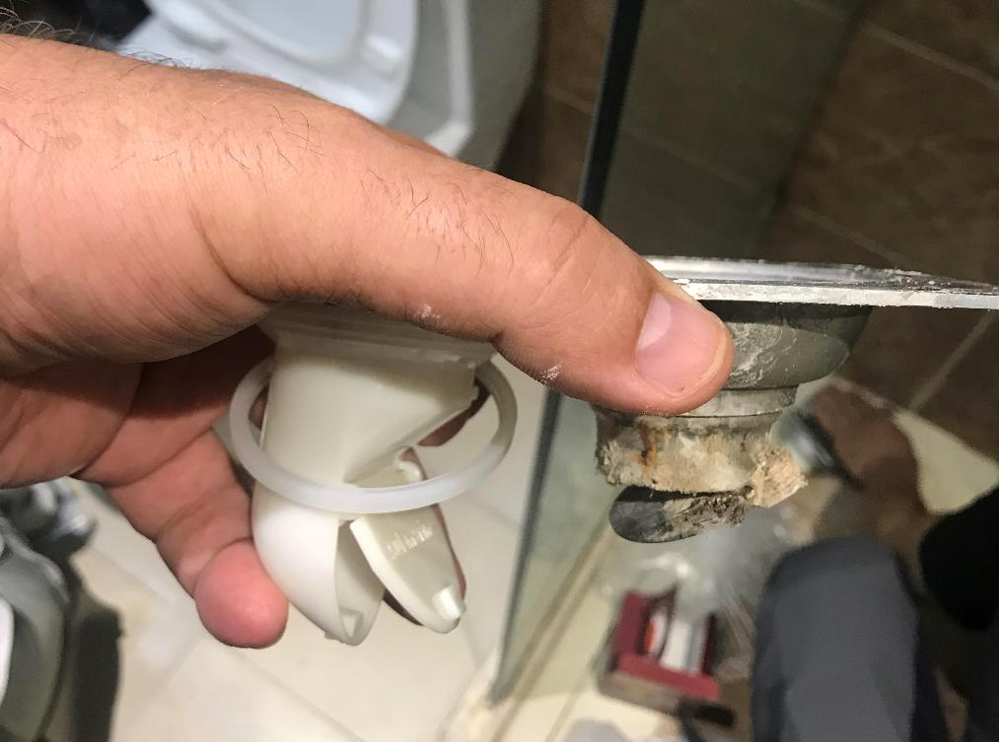
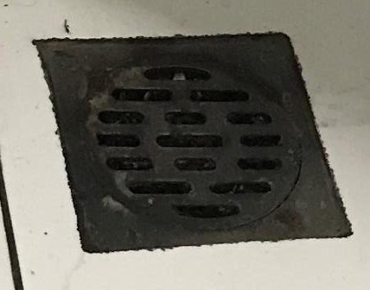
Only P-Trap, No Flapper Valve 仅 P 型疏水阀，无挡板阀
Flapper valve lets sewer gas go through
挡板阀让下水道气体通过
Professor Alex A. Volinsky, Ph.D.
20

Slide 21
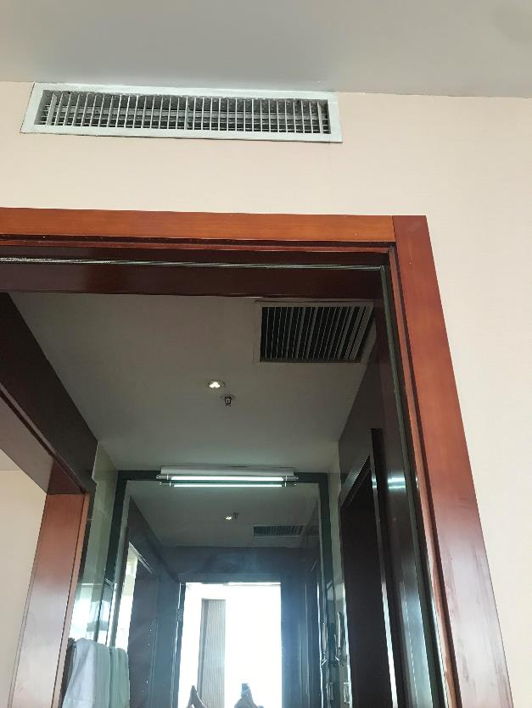
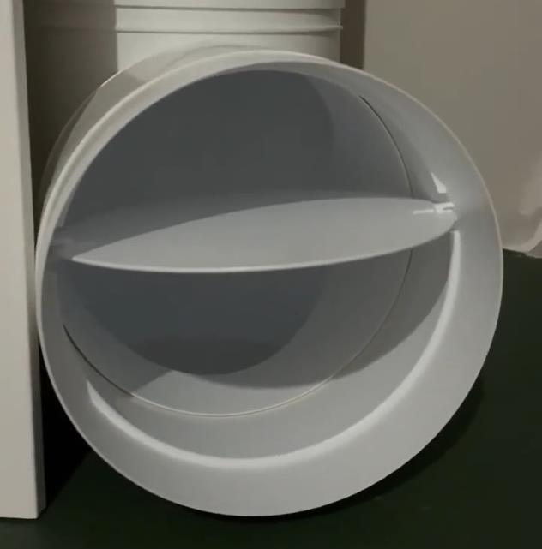
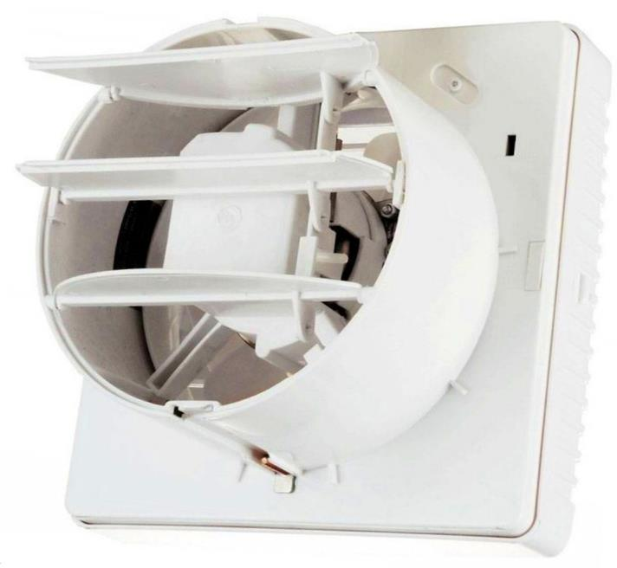
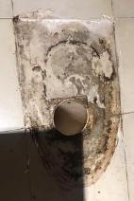
Ventilation 通风
Sewer gas comes from other rooms through ventilation vents
下水道气体通过通风口来自其他房间
Causes of Odor in Kitchens, Bathrooms, and Toilets of Multi-story Residential Apartments with Natural Ventilation, A.A. Volinsky, International Journal of Civil Engineering and Technology, Vol. 15(1), pp. 27-35, 2024
Professor Alex A. Volinsky, Ph.D.
21

Slide 22
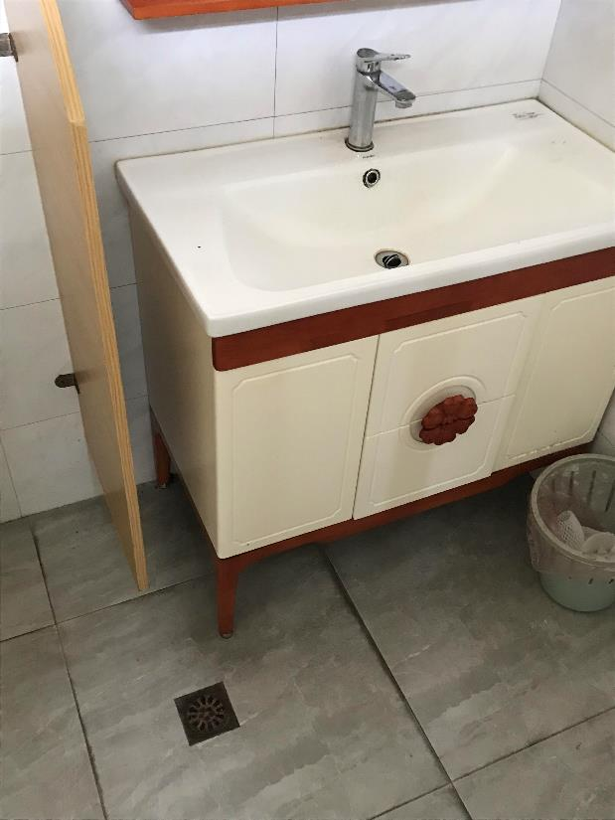
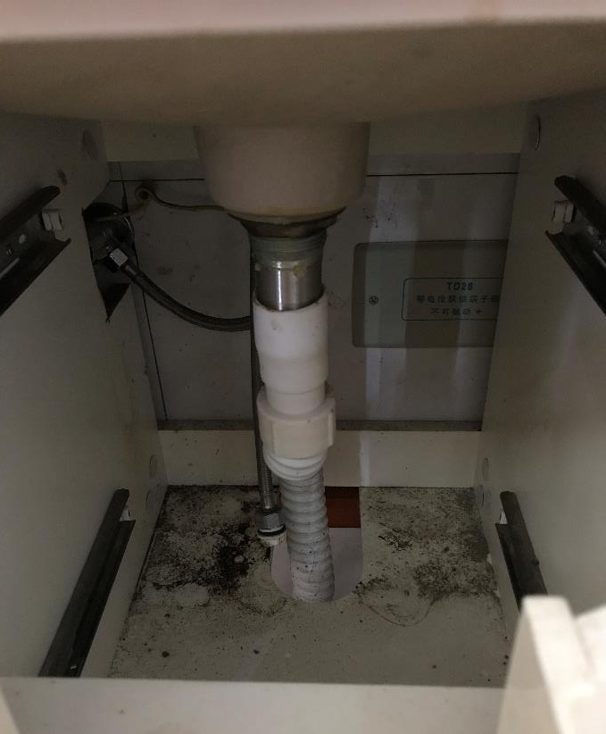
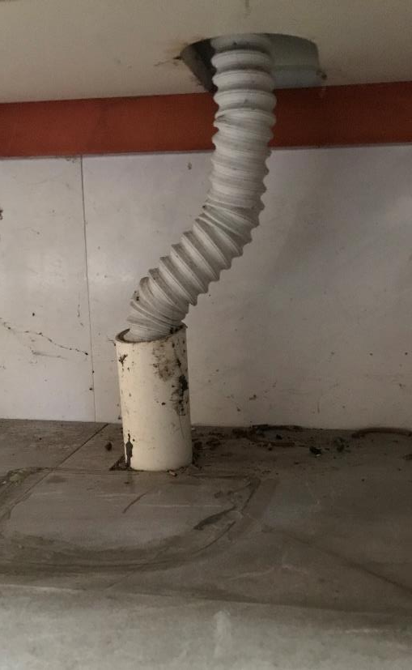
Vanity Installation 梳妆台安装
No trap 无陷阱
Double trap?
雙陷阱？
Double trap?
雙陷阱？
No pipe seal
无管道密封
Professor Alex A. Volinsky, Ph.D.
22

Slide 23



Florida Building Code 佛罗里达州建筑规范
2020 Florida Building Code, Plumbing, 7th Edition. Chapter 7 Sanitary Drainage
2020 年佛罗里达州建筑规范，管道，第 7 版。第7章 卫生排水https://codes.iccsafe.org/content/FLPC2020P1/chapter-7-sanitary-drainage
Free access online
免费在线访问
Professor Alex A. Volinsky, Ph.D.
23

Slide 24
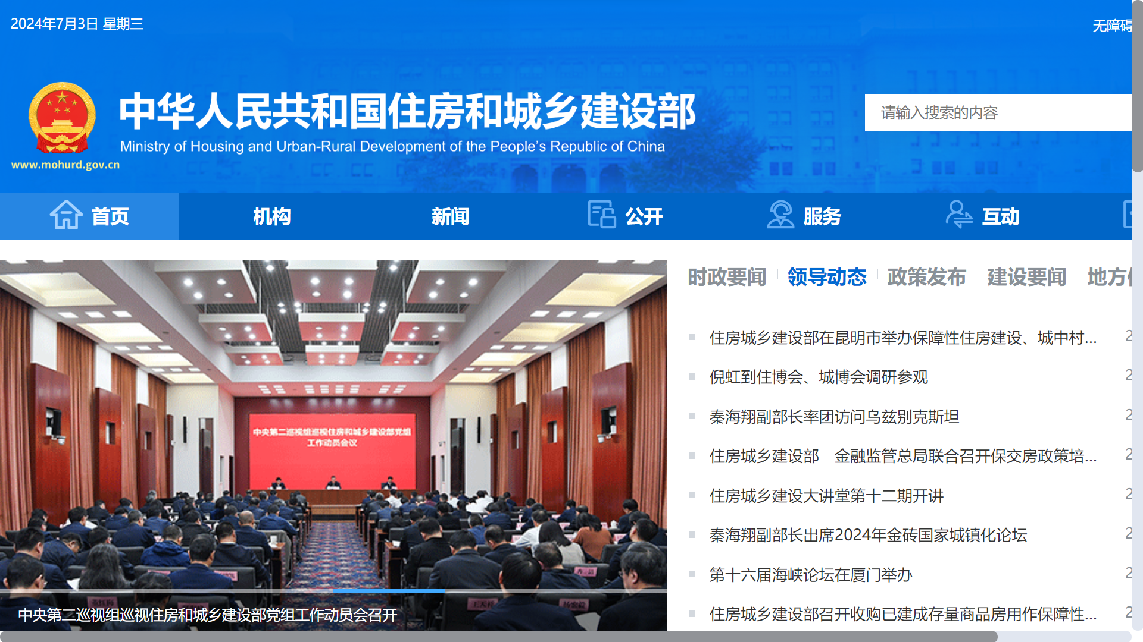
住房和城乡建设部
Building safety in China is regulated by the Ministry of Housing and Urban Rural Development (MOHURD) through a series of building safety standards
中国的建筑安全由住房和城乡建设部 (MOHURD) 通过一系列建筑安全标准进行监管
Professor Alex A. Volinsky, Ph.D.
24

Slide 25
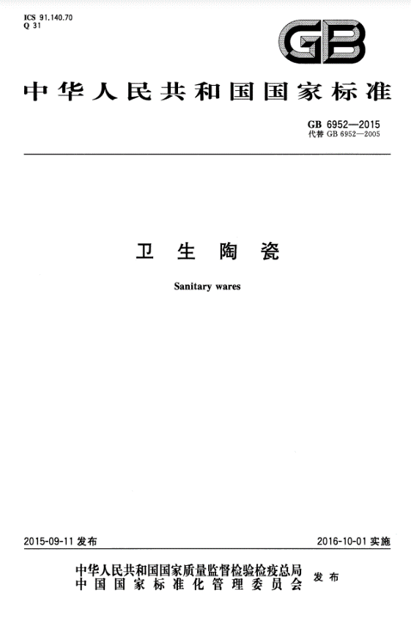
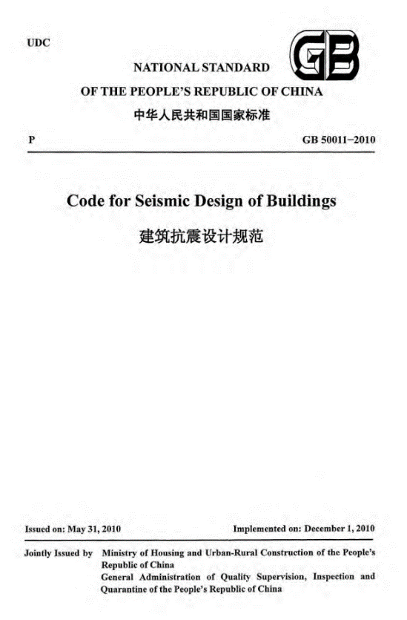
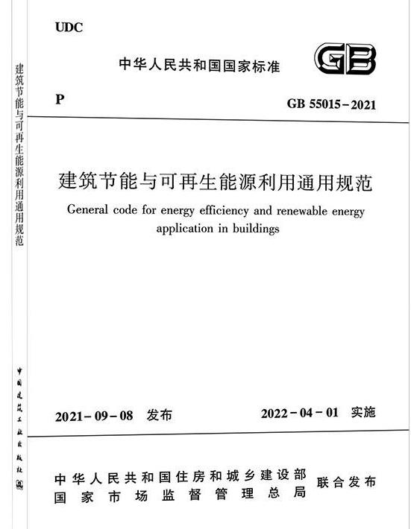
National Standards 國家標準
Which national standard requires P-trap and specifies proper toilet installation?
哪个国家标准要求 P 型存水弯并规定了马桶的正确安装？
Professor Alex A. Volinsky, Ph.D.
25

Slide 26
Publications 刊物
中国为什么会发出恶臭？——浅析中国管道和通风系统存在的不足 Why China Stinks? Deficiencies in Chinese Plumbing and Ventilation Systems (in Chinese), A.A. Volinsky, Y. Liu, 2018
Why China Stinks. Deficiencies in Plumbing and Ventilation Systems in China, A.A. Volinsky, International Journal of Civil Engineering and Technology, Vol. 11(7), pp. 16-20, 2020
Causes of Odor in Kitchens, Bathrooms, and Toilets of Multi-story Residential Apartments with Natural Ventilation, A.A. Volinsky, International Journal of Civil Engineering and Technology, Vol. 15(1), pp. 27-35, 2024
Причины Неприятного Запаха в Ванных Комнатах и Туалетах Квартир МКД (Causes of a Nuisance Odor in the Bathrooms and Toilets of Apartments in Multi-story Buildings, in Russian), A.A. Volinsky, С.О.К. Сантехника, Отопление, Кондиционирование, 8, 46-48, 2022. S.O.K. Plumbing, Heating, Air-conditioning, Vol. 8, pp. 46-48, 2022
Почему в Китае Плохо Пахнет. Недостатки Канализационных Систем в Китае (Why China Stinks. Deficiencies in Plumbing Systems in China, in Russian), A.A. Volinsky, С.О.К. Сантехника, Отопление, Кондиционирование, 10, 22-24, 2021. S.O.K. Plumbing, Heating, Air-conditioning, Vol. 10, pp. 22-24, 2021
Professor Alex A. Volinsky, Ph.D.
26

Slide 27
Other Useful Publications 其他有用的出版物
A Case of Psoriasis Treatment Using Psorinum Autonosode, A.A. Volinsky, International Journal of Homoeopathic Sciences, Vol. 7(2), Part G, pp. 457-459, 2023
Two Cases of Isopathic and Homeopathic Treatment of Coronavirus Disease 2019, A.A. Volinsky, S.V. Gunter, International Journal of Homoeopathic Sciences, Vol. 5(3), Part E, pp. 321-323, 2021
A Clinical Case of Chronic Tonsillitis Treatment Using Homeopathy and Autonosodes, A.A. Volinsky, International Journal of Homoeopathic Sciences, Vol. 5(1), Part C, pp. 152-154, 2021
A Clinical Case of Homeopathic and Isopathic Treatment of Human Herpes Simplex Virus, A.A. Volinsky, International Journal of Homoeopathic Sciences, Vol. 5(1), Part C, pp. 146-148, 2021
Allergy Desensitization Based on Allergens Dynamization Method, A.A. Volinsky, International Journal of Homoeopathic Sciences, Vol. 4(4) Part D, pp. 198-201, 2020
Modified Qigong Breathing Exercise for Reducing the Sense of Hunger on an Empty Stomach, A.P. Voroshilov, A.A. Volinsky, Z. Wang, E.V. Marchenko, Journal of Evidence-based Complementary & Alternative Medicine, Vol. 22(4), pp. 687-695, 2017
Professor Alex A. Volinsky, Ph.D.
27

Slide 28
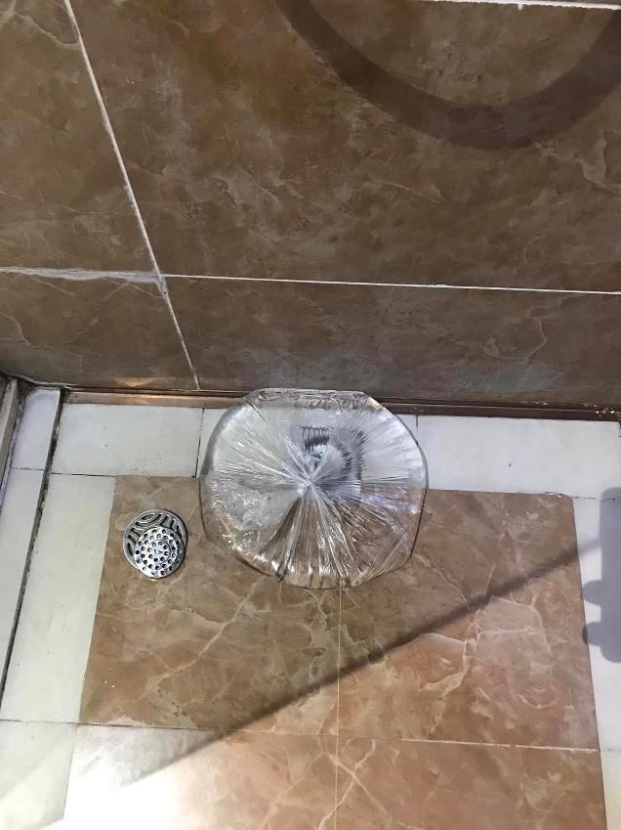
In the mean time 同时
I will keep putting plastic bag with water over all floor drains and avoid hotels with stinky sewage gas smell, make P-trap from flexible pipe, when possible, block ventilation vents, keep windows open.
Or maybe not travel to China at all, until these problems are fixed. Probably not in my lifetime.
我会继续用装有水的塑料袋覆盖所有地漏，并避开有恶臭污水气味的酒店，用软管制作P型存水弯，如果可能的话，堵塞通风口，保持窗户打开。
或者，在这些问题得到解决之前，也许根本不会去中国旅行。在我的一生中可能不会。
If problems like this happened in the US, the whole building would be shutdown 如果美国出现这样的问题，整个大楼都会被关
Professor Alex A. Volinsky, Ph.D.
28

Slide 29
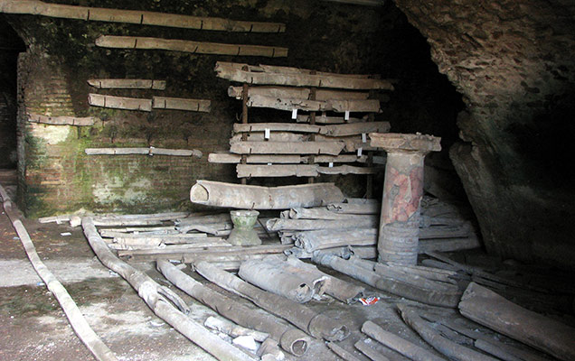
Ancient Rome Lead Pipes 古罗马铅管
In Ancient Rome lead was used for water pipes.
The word "plumbing" derives from plumbum, the Latin word for lead.
Don’t let sewer gas bring down Chinese Nation.
在古罗马，铅被用于水管。
“管道”一词源自拉丁语“plumbum”，意为“铅”。
别让下水道毒气毁了中华民族。
Tap water from ancient Rome likely contained up to 100 times more lead than local spring water
Thomas Sumner, ScienceShot: Did Lead Poisoning Bring Down Ancient Rome? Sediments downstream from Rome reveal health risks of empire's plumbing, Science, 21 Apr. 2014
In Nazi Germany people were killed in gas chambers in concentration camps.
在纳粹德国，人们在集中营的毒气室中被杀害。
Professor Alex A. Volinsky, Ph.D.
29

Slide 30
Conclusions 结论
Sewer gas exposure is a grossly neglected severe systemic problem in China
下水道气体暴露是中国一个被严重忽视的严重系统性问题
Every bathroom has a floor drain without a water trap. Air flapper in the drain is no good. 每个浴室都有地漏，没有存水弯。排水管中的空气挡板不好。
Sink installations are missing a water trap. Sink drain flapper is no good.
水槽安装缺少聚水器。水槽排水挡板不好。
Toilets are improperly installed and are not sealed 廁所安裝不當且未密封厕所安装不当且未密封
Sewer gas is transported through ventilation systems from other apartments.
下水道气体通过其他公寓的通风系统输送。
Ministry of Housing and Urban Rural Development must address and fix these problems. 住房和城乡建设部必须正视和解决这些问题。
Professor Alex A. Volinsky, Ph.D.
30

